Slide 1
Why pseudo-complex General Relativity
and application to gravitational waves
P.O.Hess (ICN-UNAM)
P.O. Hess,”Alternatives to Einstein’s General Relativity Theory,
Progress in Particle and Nuclear Physics 114 (2020), 103809.

Slide 2
CONTENT
Introduction
Algebraic extensions (in coordinates and metrics)
Some predictions of pc-GR: A bright ring around a blñack hole and properties of gravitational waves
Conclusions

Slide 3
Introduction
It is not sure if GR is still valid in strong gavitational fields.
Problems with loss of information, quantization effects, event-horizon, singularities, all signs that something maybe missing.
In the past several attempts to extend GR have been made, related to change the metric or the coordinates.

Slide 4
First attempts: a ) A. Einstein
Motivations: To unify GR with Electrodynamics
Problem: In the weak field limit the complex part does not approach
the Maxwell equations.

Slide 5
First attempts: b) M. Born
Motivation: In Quantum Mecanics coordinates and momentum are
treated on equal footing. In GR coordines play the dominant role
ADDING
→
Metric in momentum-energy space:
MAXIMAL ACCELERATION!

Slide 6
Algebraic extensions
Algebra:

Slide 7
Weak field limit
with
→
a_i**2→C_{ii}
leads to ghost solutions!
Only the pc-extension is save. This is the reason
why to study the pseudo-complex extension
and not others!

Slide 8
pseudo-complex Extension-1

Slide 9
pseudo-complex Extension-2

Slide 10
pc-GR
P.O.Hess, M. Schäfer, W. Greiner: Pseudo-complex General Relativity,
Springer 2015
→
→
with

Slide 11
Un modelo fenomenológico
[
r**6]
Due to the non-existence of a theory of quantum gravity:
use phenomenology
Nielsen A., Birnholz O.,AN 2018, 339, 298.
Nielsen A., Birnholz O.,AN 2019, 340, 116.
n>3

Slide 12
The principle behind is: A mass not only curves the space as described in General Relativity, but also changes the vaccum properties around it (due to quantum effects), having in turn an effect on the metric

Slide 13
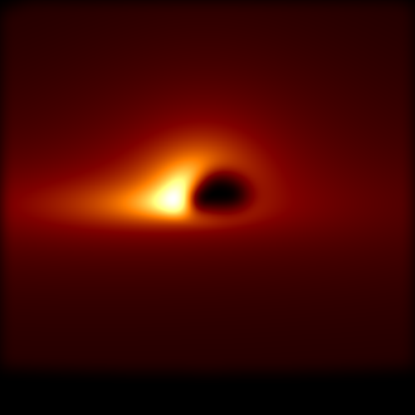
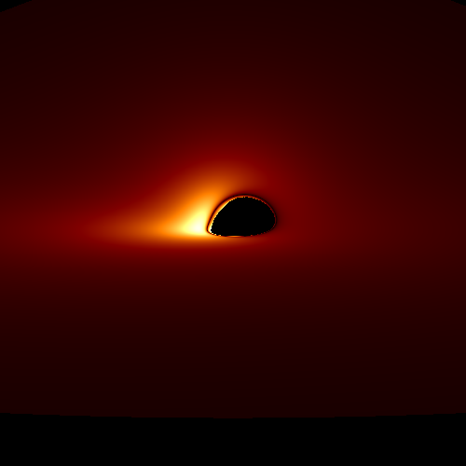
Resolution 0.5μas
80 degrees inclination
Resolution aprox. 20μas
80 degrees inclination, DETAILS
ARE LOST!
(a=0.8)
M87

Slide 14
redshift
We cannot tell anything about the property of the Surface
How strong te magnetic field can be?, etc.
Only infomation about the redshift: Increases toward 90
degrees and with inceasing a, the redshift is decreased
at the poles. → posible observable emision near poles
for rapidly rotating stars, but they are overshine by jets.
From above:
a=0.2m
a=0.5m
a=0.8m
a=1.0m

Slide 15
Stability of the Schwarzschild solution
Chandrasekhar’s book; The mathematical theory of black holes
15
Notes:
15

Slide 16
The field equation for gravitational wave: Axiel and Polar
A rather lengthy, but straight forward derivation leads to:
m=m(r)!
16
Notes:
16

Slide 17
A new analytic solution for the Tortoise coordinate
GR
pc-GR

Slide 18
Asymptotic behavior
TOTAL:

Slide 19
Axial modes:
GR:
400 iterations
pc-GR:

Slide 20
AN, October (2021), online
Comaring axial
to polar modes:
Left columna:
axial modes
Right columns:
polar modes
red: 300 iterations
green: 400 iterations
blue: 500 iterations

Slide 21
Conclusions:
pc-GR is the only viable algebraic extensión of GR (unites ideas with M. Born and others)
pc-GR makes definite predictions:
1) A dark ring followed further in by a bright ring in an accretion disk. Unfortunately, resulution of EHT not Good enough to see it: Hope: future improvements in the resolution of EHT
2) Frequencies of gravitational waves show differences to GR at LARGE DAMPING. The problema is how to extract these frequencies.

