Slide 1


FU Orionis: a case study for understanding the formation of complex substructures within protoplanetary disks of eruptive stars
XXXI Peruvian Physics Symposium at Universidad Nacional Mayor de San Marcos (UNMSM)
Author: BSc. Erick Montoya*
Supervisor: Dr. Sebastián Pérez**
*: First-year Physics PhD student at Universidad de Santiago de Chile (USACH) and Nucleus Millennium on Young Exoplanets and their Moons (YEMS). Email: erick.montoya@usach.cl
**: Alternate director of Nucleus Millennium YEMS.
December 19th 2025, Lima, Peru.

Slide 2
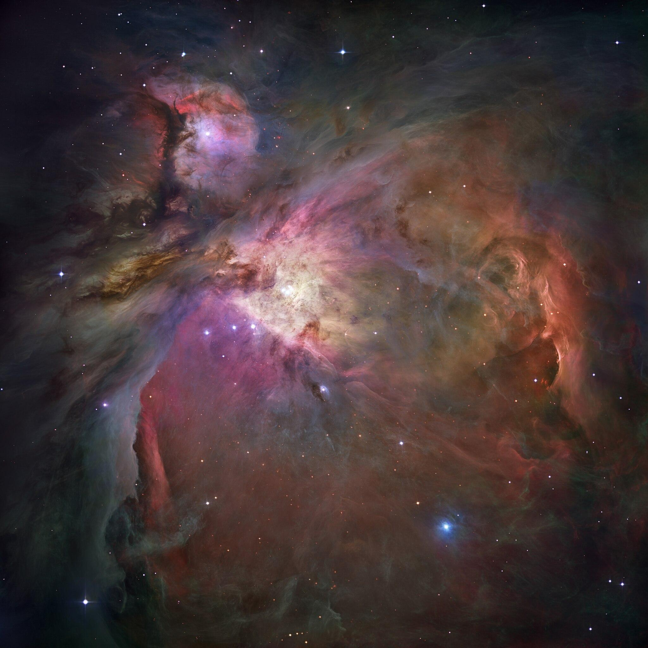
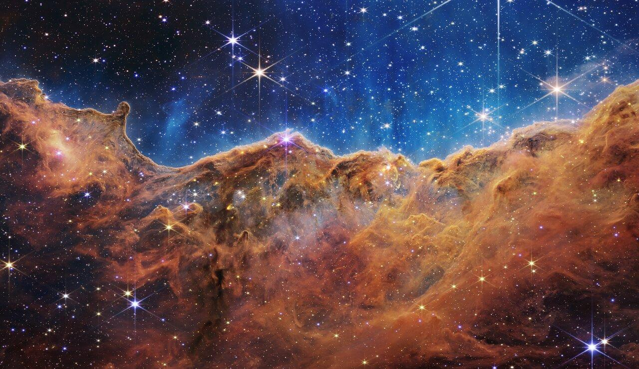
What exactly is a protoplanetary disk?
It all begins in star-forming regions within molecular clouds.
Orion Nebula (HST) Carina Nebula (JWST)
Molecular clouds are made mostly of cold gas (H2, He and CO) and dust (silicates and carbon).
XXXI Peruvian Physics Symposium (FCF - UNMSM)

Slide 3
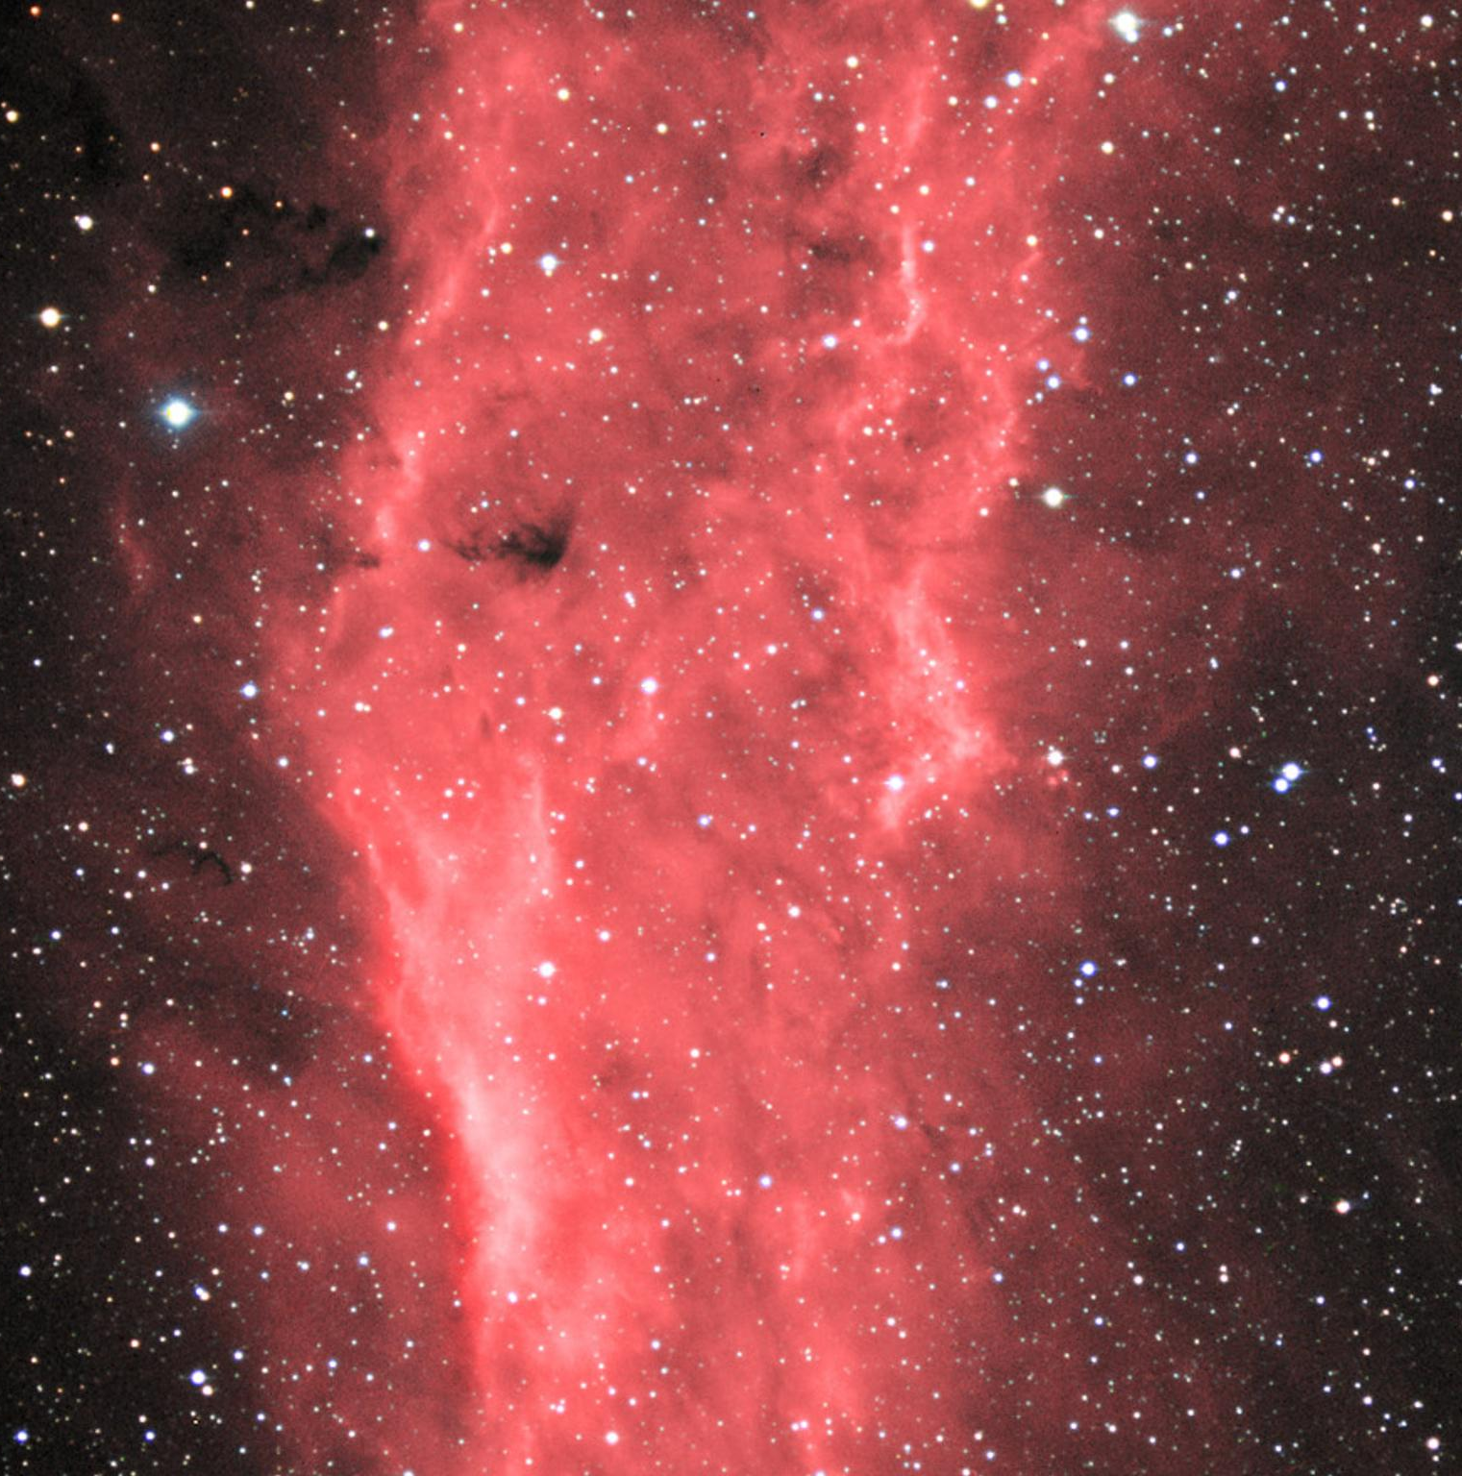
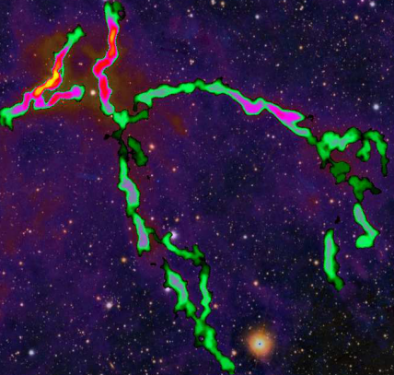
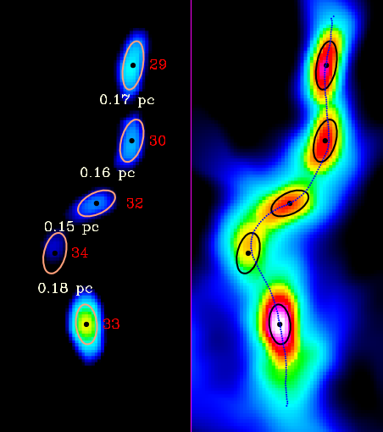
What exactly is a protoplanetary disk?
Our current picture of how disks may form.
Molecular cloud Filaments Prestellar cores
California Nebula (NOIRLab) Zhang et al. (2020) Zhang et al. (2020)
External forces shape some regions of molecular clouds into fiber-like structures called filaments which subsequently fragment into more spherical structures called prestellar cores (no stars yet).
XXXI Peruvian Physics Symposium (FCF - UNMSM)

Slide 4
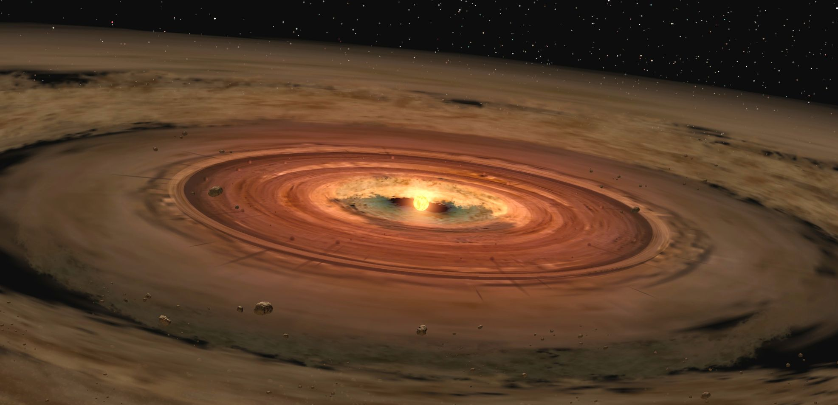
What exactly is a protoplanetary disk?
The prestellar cores continue collapsing and shrinking which heats up the material. Eventually, the center of the prestellar cores heats up so much that nuclear fusion reactions ignite the material in that region and a star is formed. The rest of the material keeps rotating around and falling into (accretion) the newly-formed star. This is what we call a protoplanetary disk.
Prestellar cores Protoplanetary disk
Zhang et al. (2020) NASA/JPL
XXXI Peruvian Physics Symposium (FCF - UNMSM)

Slide 5
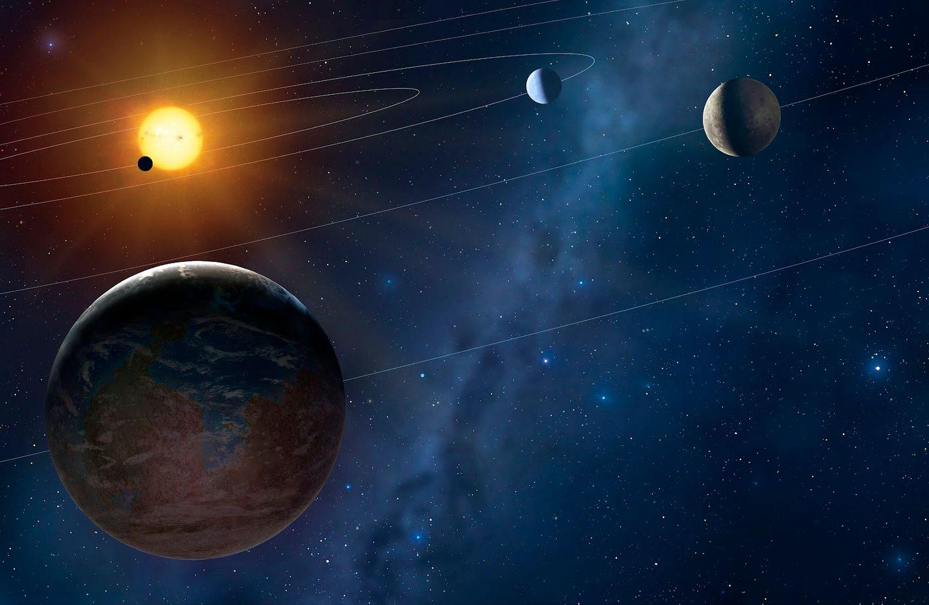
What exactly is a protoplanetary disk?
As the gas and dust are accreted onto the star or are used to make minor and major bodies,, the disk gets depleted and eventually vanishes after around 10 Myr. Once the disk is mostly depleted and the planets are formed, the protoplanetary disk phase is over and enters a quasi-static phase.
Protoplanetary disk Extrasolar system
NASA/JPL Naver blog
A new extrasolar system has been born.
XXXI Peruvian Physics Symposium (FCF - UNMSM)

Slide 6
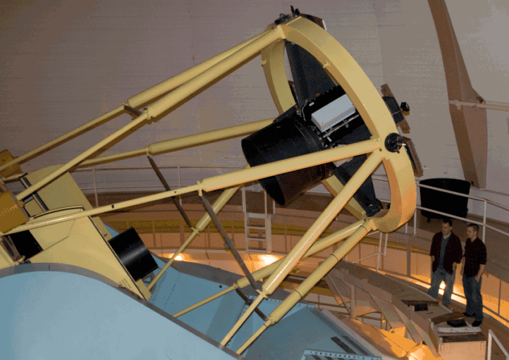
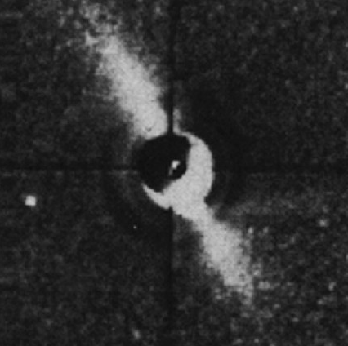
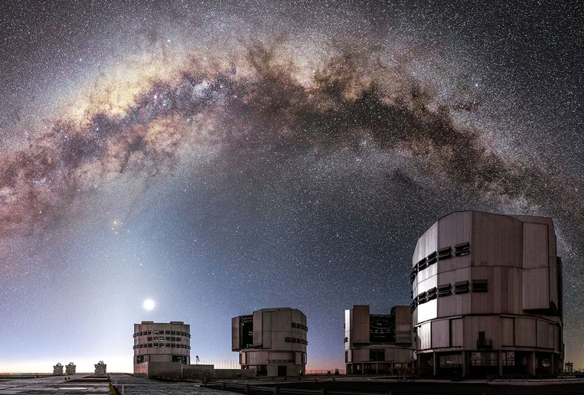
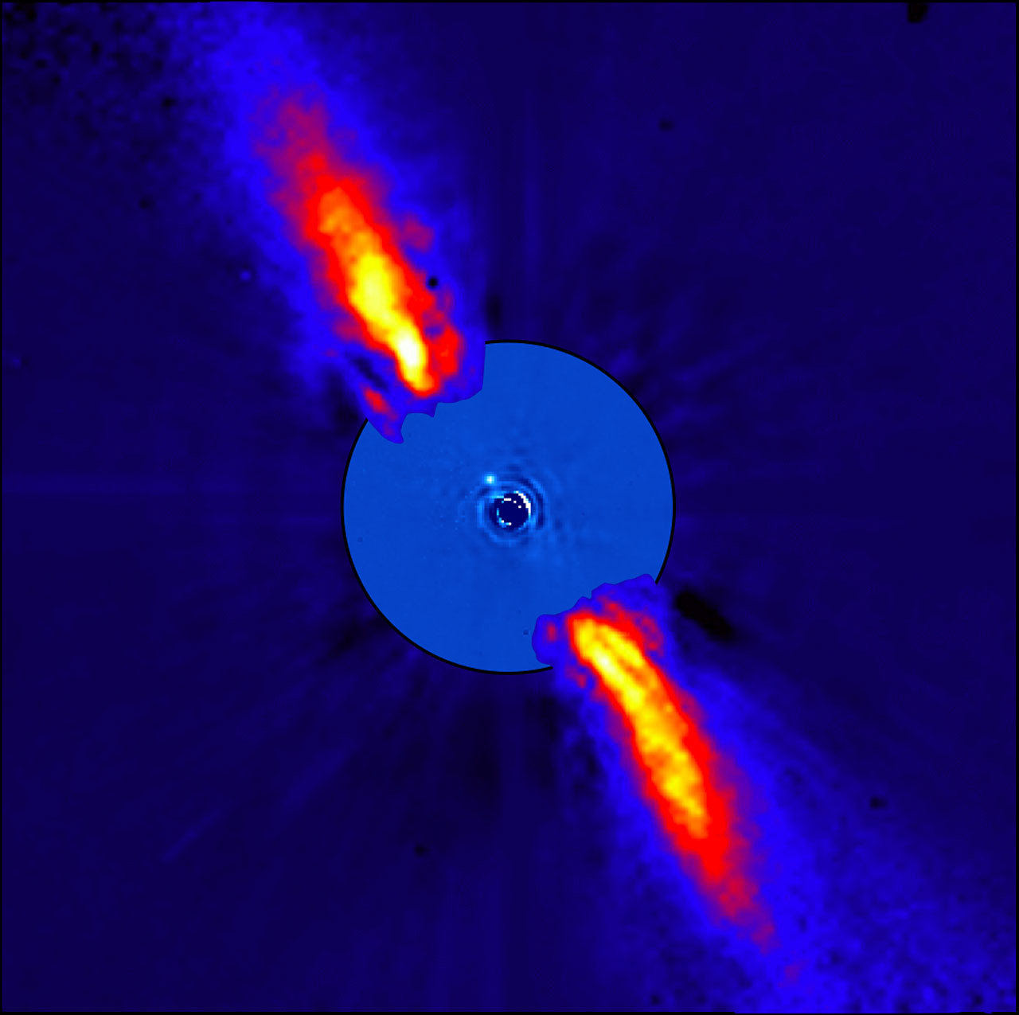
Better instruments, better quality of data
Smith and Terrile (1984)
Images of Beta Pictoris (First disk observed)
Very Large Telescope (VLT) DuPont Telescope
MIT
Lagrange et al. (2009)
Miguel Claro (ESO)
XXXI Peruvian Physics Symposium (FCF - UNMSM)

Slide 7
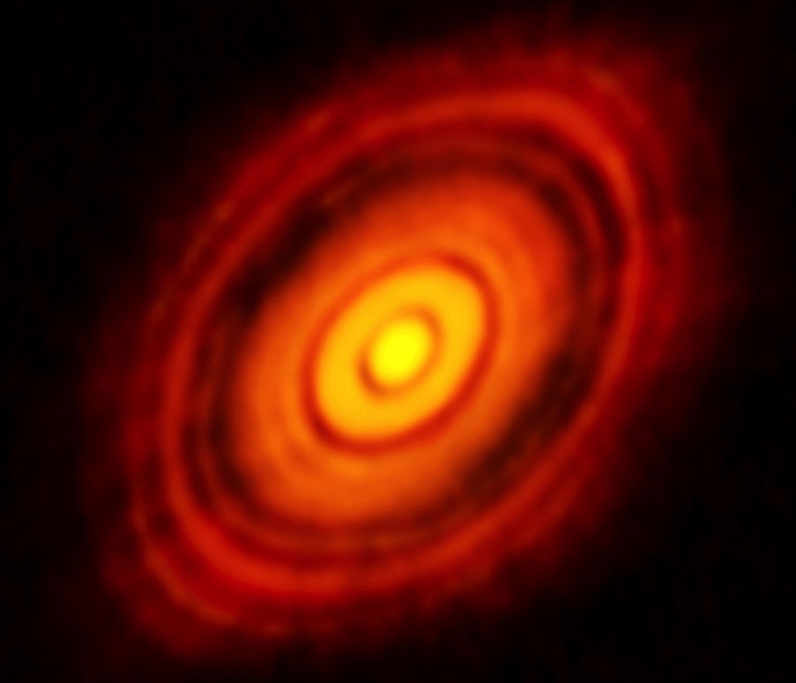
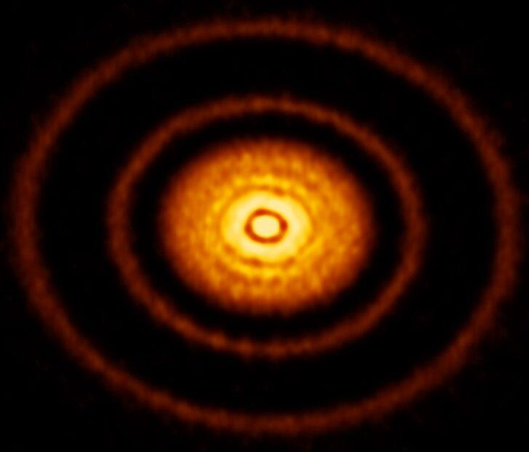
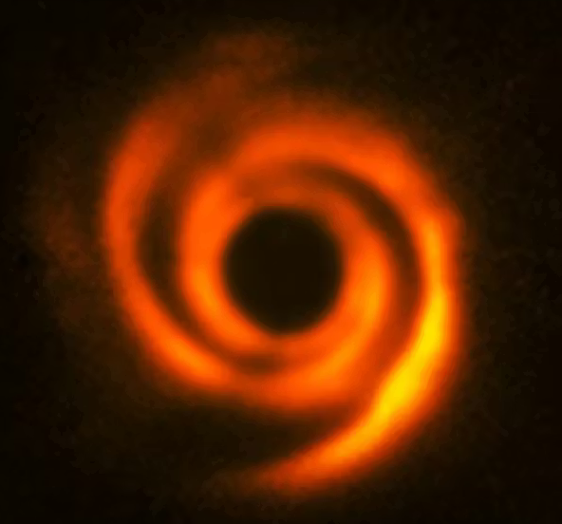
Better quality of data, better understanding
Some facts have become undeniable over the recent years:
1.- Most protoplanetary disks exhibit complex substructures: gaps, rings, cavities and spirals.
HL Tau AS 209 HD 135344B
XXXI Peruvian Physics Symposium (FCF - UNMSM)

Slide 8
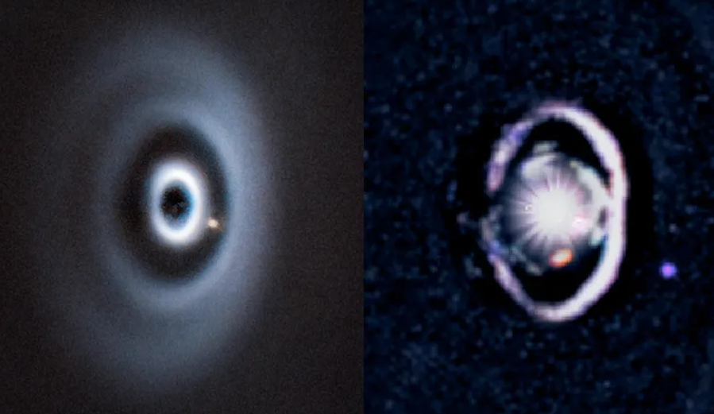
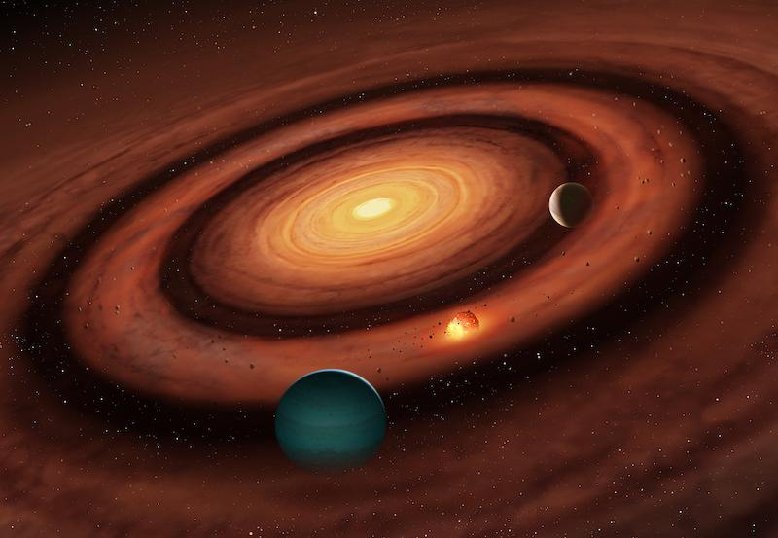
Refining our picture of protoplanetary disks
2.- Gaps and rings are most likely created by already-formed planets cleaning their orbits.
Van Capelleveen et al. (2025) University of Warwick
3.- This means that planets must form at an early stage of the protoplanetary disk lifetime. The cause of this rapid formation of planets is still debated.
XXXI Peruvian Physics Symposium (FCF - UNMSM)

Slide 9
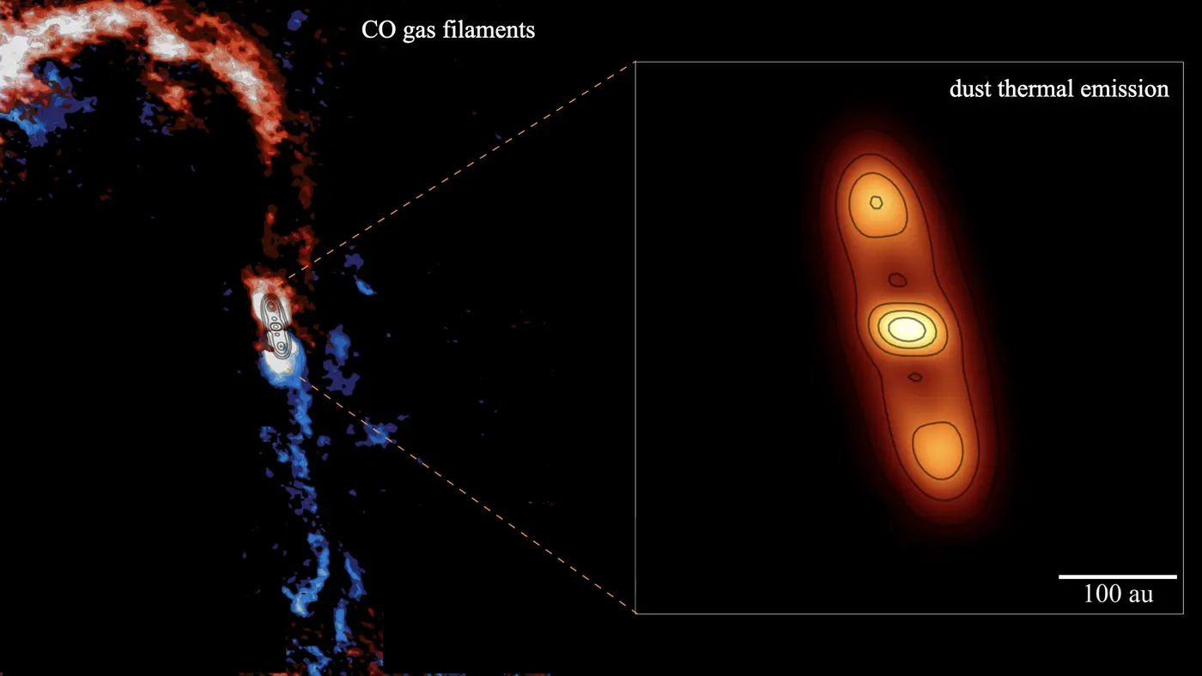
Refining our picture of protoplanetary disks
3.- The environment may play a major role in the evolution of protoplanetary disks interacting via material supply and ambient magnetic field. Some spiral arms might be caused by the infalling of material from the parental molecular cloud via thin cylindrical structures called streamers.
Alves et al. (2020)
XXXI Peruvian Physics Symposium (FCF - UNMSM)

Slide 10
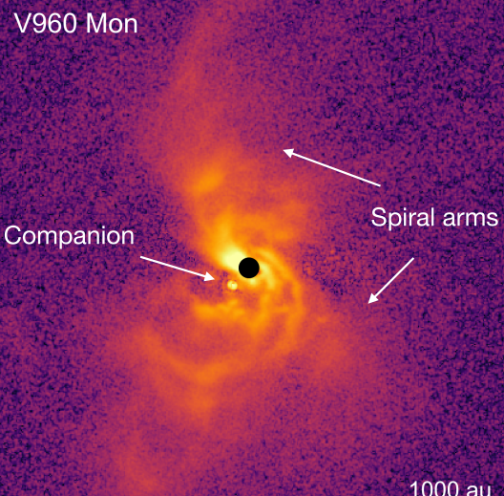
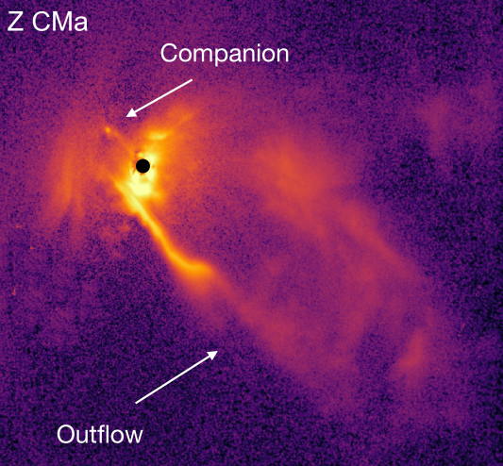
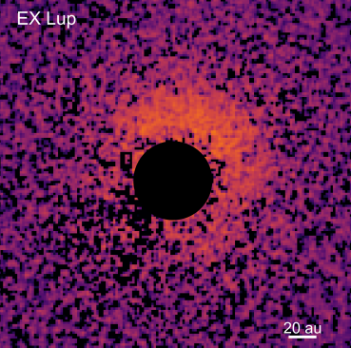
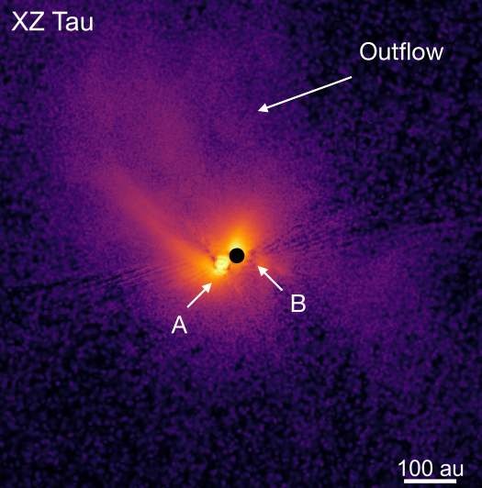
Young eruptive stars
They are pre-main sequence stars (age < 10 Myr, still displaying disks) whose luminosity undergoes abrupt, episodic increases of several orders of magnitude called outbursts. Two classes are known:
FUor: powerful decade-long outbursts
EXor: frequent month-long outbursts
Zurlo et al. (2024) Zurlo et al. (2024)
Most of their protoplanetary disks exhibit very complex non-axisymmetric substructures.
XXXI Peruvian Physics Symposium (FCF - UNMSM)

Slide 11
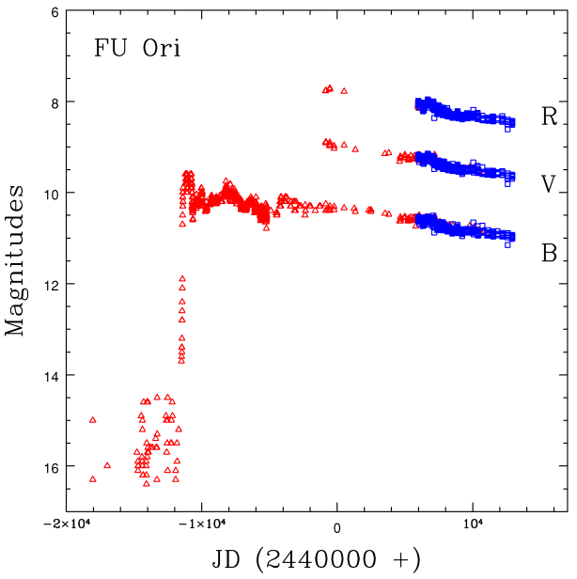
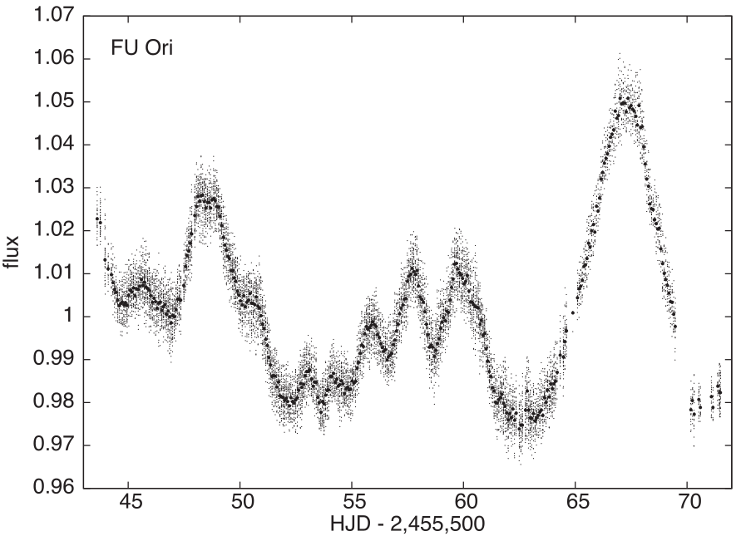
FU Orionis: the prototype of its class (FUor)
In 1937, a star known as FU Orionis underwent a major outburst which raised its apparent blue magnitude from 16.5 to 9.6! Since then its luminosity has been decreasing very slowly.
Clarke et al. (2005) Siwak et al. (2013)
XXXI Peruvian Physics Symposium (FCF - UNMSM)

Slide 12
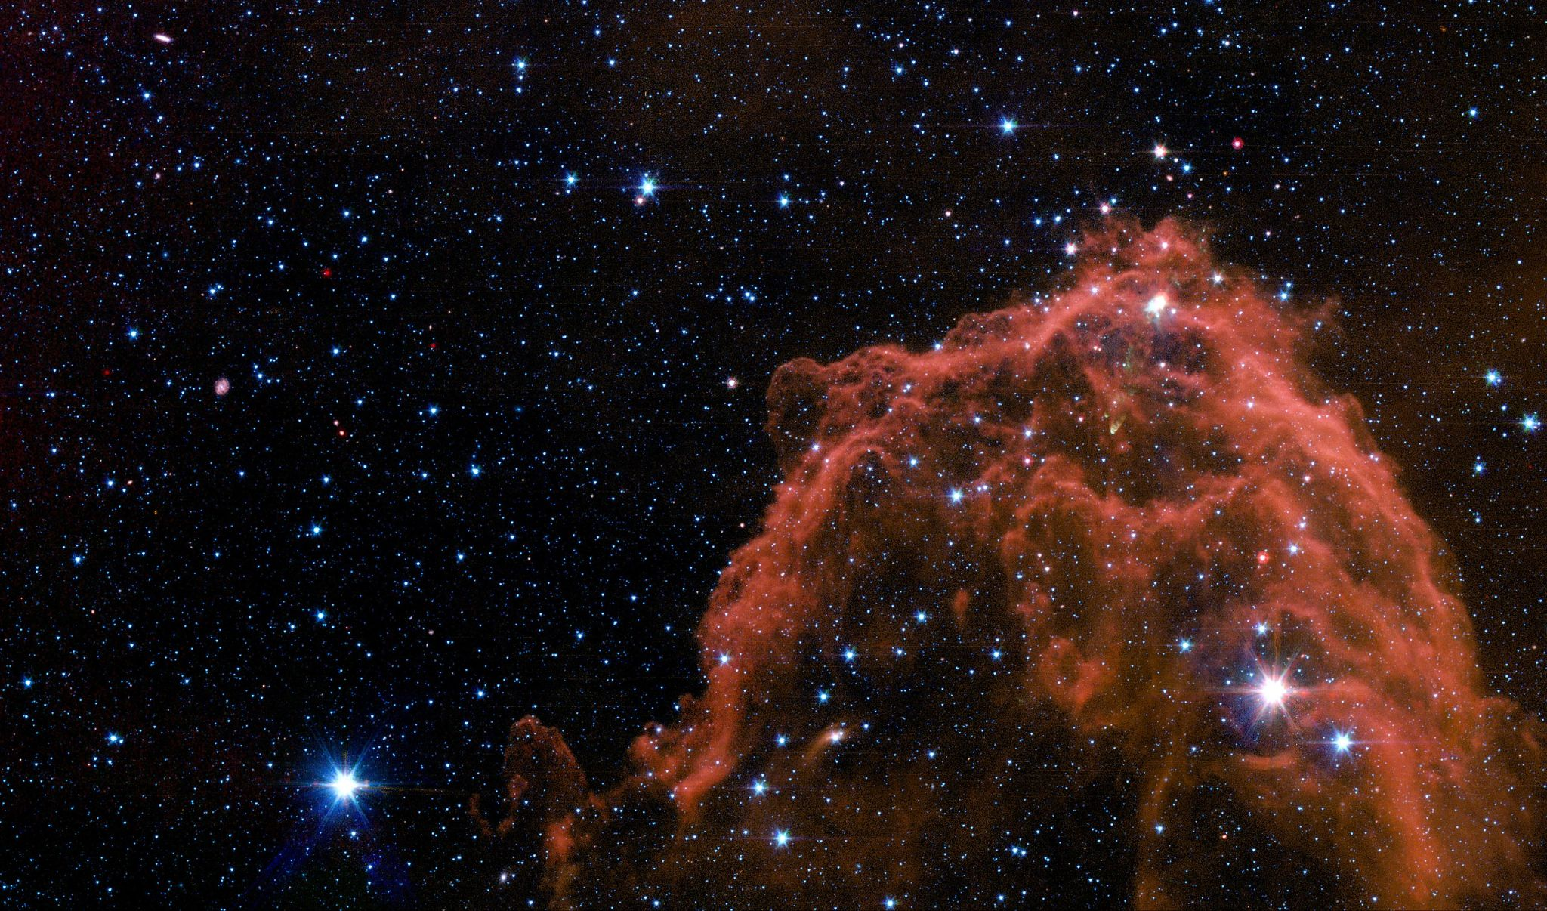
FU Orionis: the prototype of its class (FUor)
Binary star (North* and South)
Associated with the molecular cloud Barnard 35
Mass FUOriN*: ~0.6 solar masses
Mass FUOriS: 1.2 solar masses
XXXI Peruvian Physics Symposium (FCF - UNMSM)
Spitzer Space Telescope

Slide 13
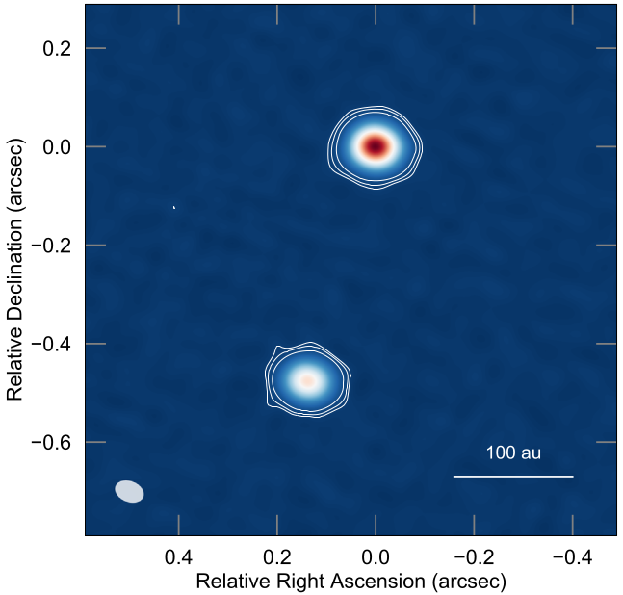
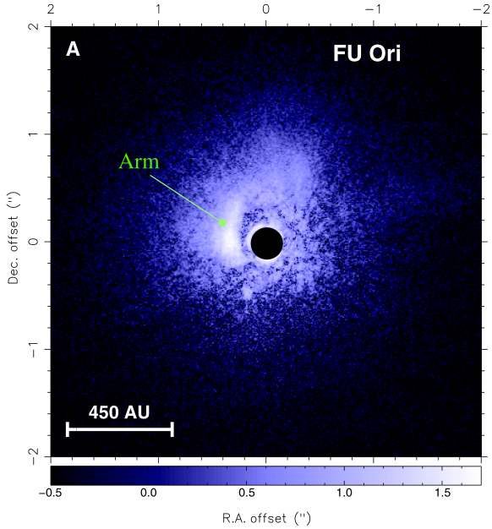
The complex disk of FU Orionis
Continuum observations only reveal very compact disks (R < 10 AU) around both stars.
But μm-dust data reveal a far more extended disk with complex substructures such as a bright spiral arm to the East of FUOriN.
Pérez et al. (2020)
Liu et al. (2016)
XXXI Peruvian Physics Symposium (FCF - UNMSM)

Slide 14
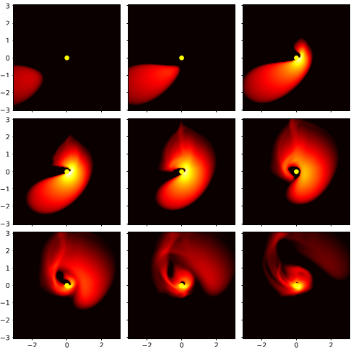
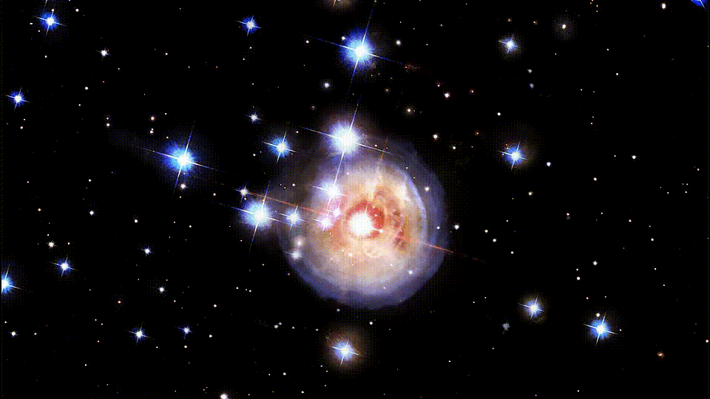
Proposed scenarios to explain disk
1.- Infalling of material via streamers.
2.- Cloudlets.
3.- Stellar flyby.
4.- Star-disk or disk-disk interaction.
5.- Gravitational Instability.
6.- The outburst created the spiral arm.
1.
2.
Alves et al. (2020)
6.
Dullemond et al. (2019)
G. Bacon (NASA and ESA)

Slide 15
The objectives of our research
1.- Use recent (2023-2024) VLT observations to measure the kinematics of the spiral arm and determine whether it exhibits radial or purely azimuthal motion.
2.- Determine the angular velocity profile of the disk to compute accurately the mass of FU Orionis which to date has only been estimated.
3.- Measure the proper motion of the companion star to find out if the spiral arm could have been caused by a close encounter with FU Orionis in the past.
4.- In combination with ALMA’s observations, run models to try to replicate the current state of the protoplanetary disk. This is fundamental to visualize the real geometry of the system.
5.- Run dynamical models replicating the different scenarios proposed for the origin of the spiral arms of the disk and determine which best explains the current aspect of the protoplanetary disk.
6.- Extend our approach and research to the protoplanetary disks of other young eruptive stars (not only FUors) to find out whether or not they can all be explained by the same scenario.
XXXI Peruvian Physics Symposium (FCF - UNMSM)

Slide 16
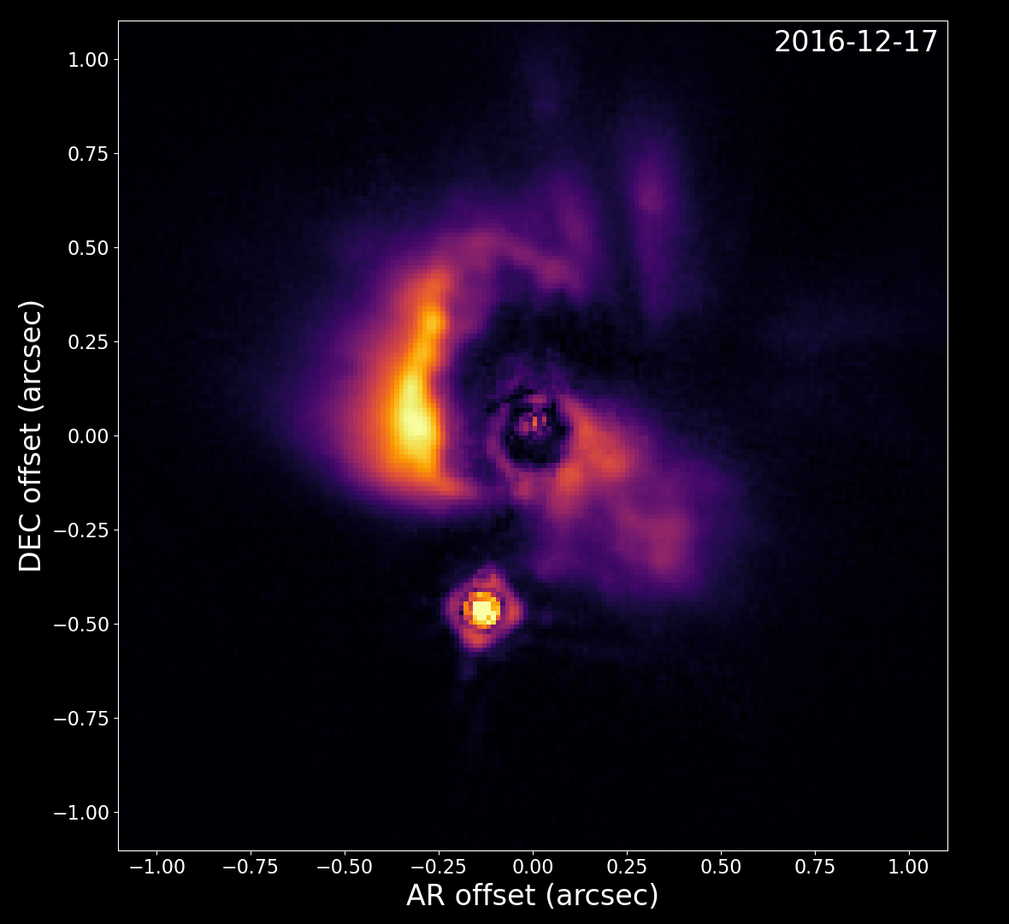
What our research has revealed so far
The VLT took images of FU Orionis in 2023-2024 which compliment the images obtained in 2016-2017. It has now become evident that:
1.- The disk rotates counter- clockwise as suggested by Pérez et al. (2020) by using ALMA’s data, whereas here the rotation is being directly observed.
XXXI Peruvian Physics Symposium (FCF - UNMSM)

Slide 17
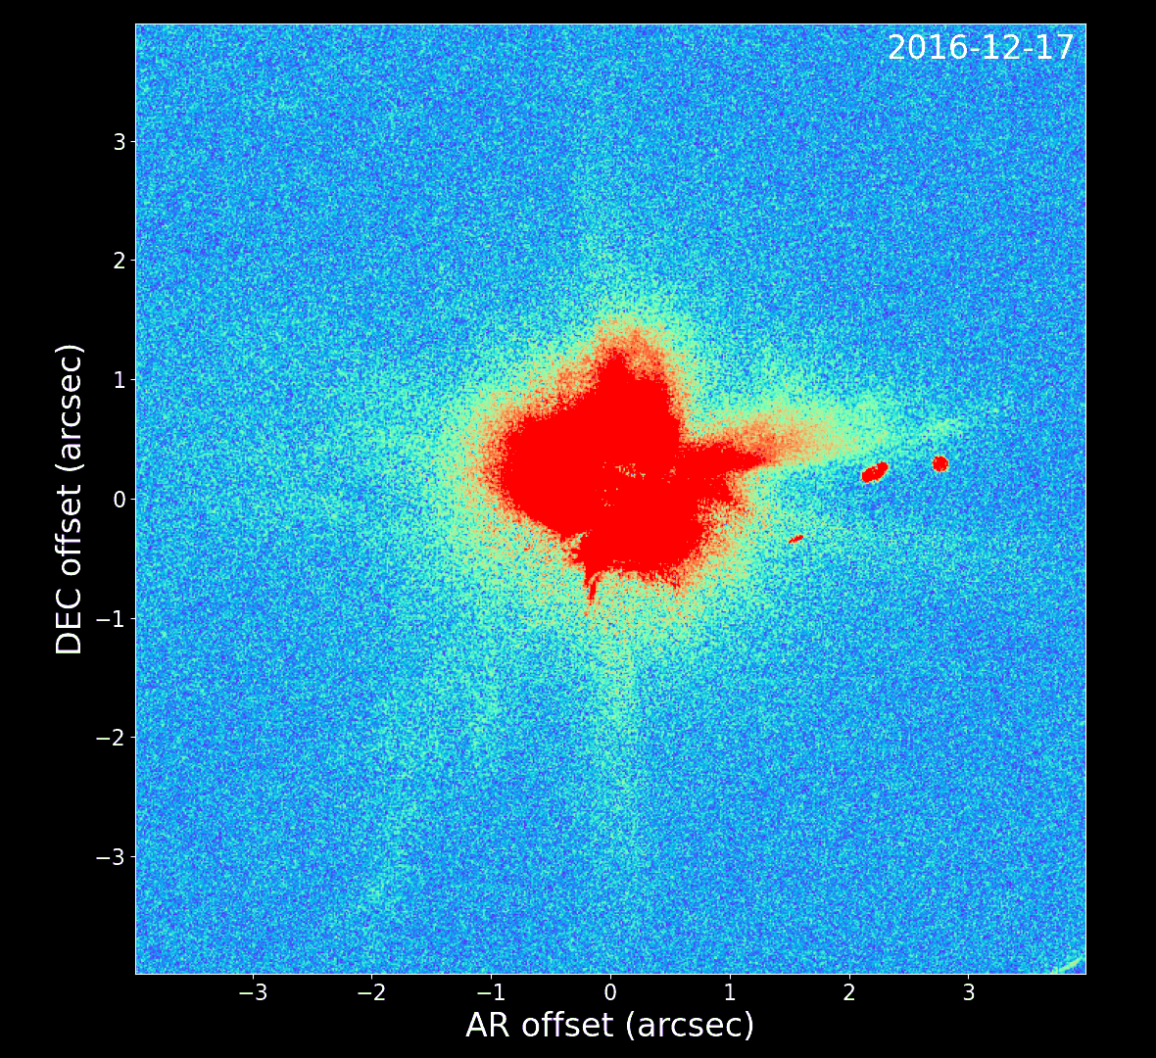
What our research has revealed so far
The VLT took images of FU Orionis in 2023-2024 which compliment the images obtained in 2016-2017. It has now become evident that:
1.- The disk rotates counter- clockwise as suggested by Pérez et al. (2020) by using ALMA’s data, whereas here the rotation is being directly observed.
2.- There are very faint structures much farther away from the disk than the spiral arm and that have not been studied in detail so far.
XXXI Peruvian Physics Symposium (FCF - UNMSM)

Slide 18
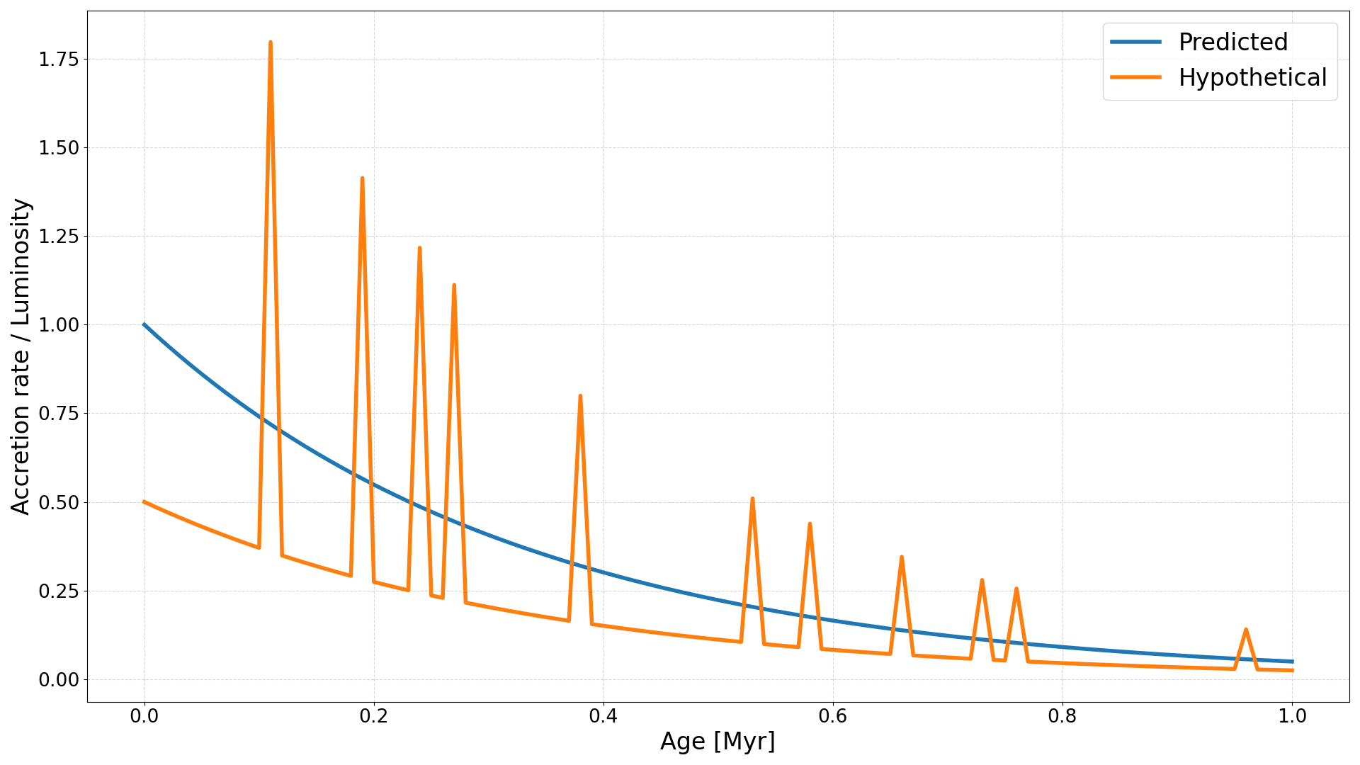
The implications of our research
1.- Our results would support the idea that studying protoplanetary disks as if they were isolated is extremely restrictive. The environment DOES MATTER!
2.- Simulations have shown that the spiral arms eventually undergo fragmentation. The mass of these fragments is so large that they give rise to very massive planets which are in general very common. Therefore it is likely that a significant fraction of present stars may have undergone episodic outbursts while forming. In fact, the composition of crystals in asteroids of our Solar System suggests that our own Sun may have also undergone episodic outbursts while forming.
3.- Given the short lifetime of protoplanetary disks, one would expect a high accretion rate and thus very luminous stars. However, in general actively accreting stars are orders of magnitude fainter than predicted. This is known as the low-luminosity problem. The leading hypothesis is that the accretion rate may not be stable, but rather rocket up during relatively short periods of time (outbursts) and remain very low for most of the protoplanetary disk evolution.
XXXI Peruvian Physics Symposium (FCF - UNMSM)

Slide 19
References
Alves et al. A case of simultaneous star and planet formation. The Astrophysical Journal Letters, 904:L6 (6pp), (2020).
Clarke C., Lodato G., Melnikov S., and Ibrahimov M. The photometric evolution of FU Orionis objects: disc instability and wind-envelope interaction. Mon. Not. R. Astron. Soc 361, 942-954 (2005).
Dullemon et al Cloudlet capture by transitional disk and FU Orionis stars. A&A 628, A20 (2019).
Lagrange et al. A probable giant planet maged in the Beta Pictoris disk. A&A 493, L21 - L25 (2009).
Pérez et al. Resolving the FU Orionis system with ALMA.: interacting twin disks?. The Astrophysical Journal Letters, 889:59 (8pp) (2020).
Siwak et al. Photometric variability in FU Ori and Z CMa as observed by MOST. Mon. Not. R. Astron. Soc 432, 194-199 (2013).
Smith B. and Terrile J. A circumstellar disk around Beta Pictoris. Science 226, 1421-1424 (1984).
Van Capelleveen et al. WIde Separation Planets In Time (WISPIT): A gap-clearing Planet in a Multi-ring Disk around the Young Solar-type Star WISPIT 2. The Astrophysical Journal Letters, 990:L8 (24pp), (2025).
Zhang Y., André P., Men’shchikov A. and Wang K. Fragmentation of star-forming filaments in the X-shaped nebula of the California molecular cloud. A&A 642, A76 (2020).
Zurlo et al. The environment around young eruptive stars. A&A 686, A309 (2024).
XXXI Peruvian Physics Symposium (FCF - UNMSM)

Slide 20
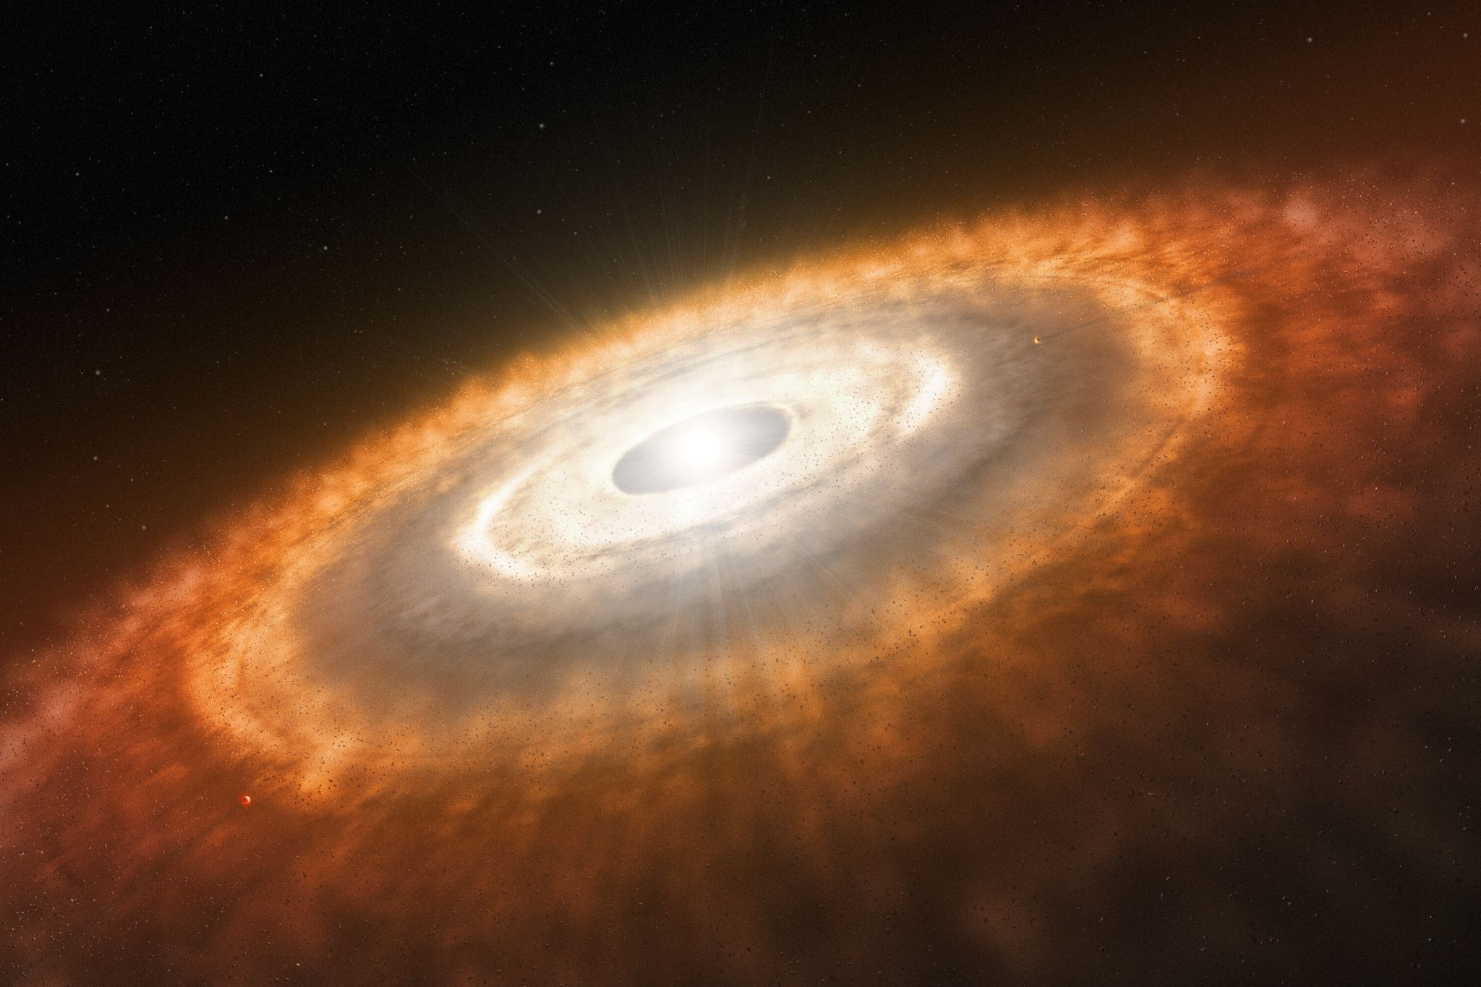
Thank you
XXXI Peruvian Physics Symposium (FCF - UNMSM)

