Slide 1
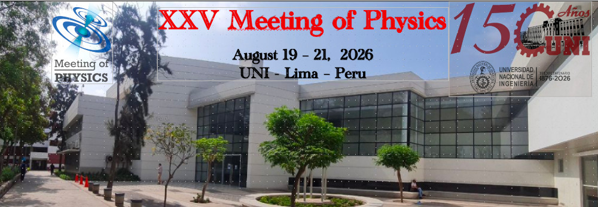


Susceptibilidad óptica no lineal basada en primeros principios en semiconductores
Angiolo Huamán et al

Slide 2
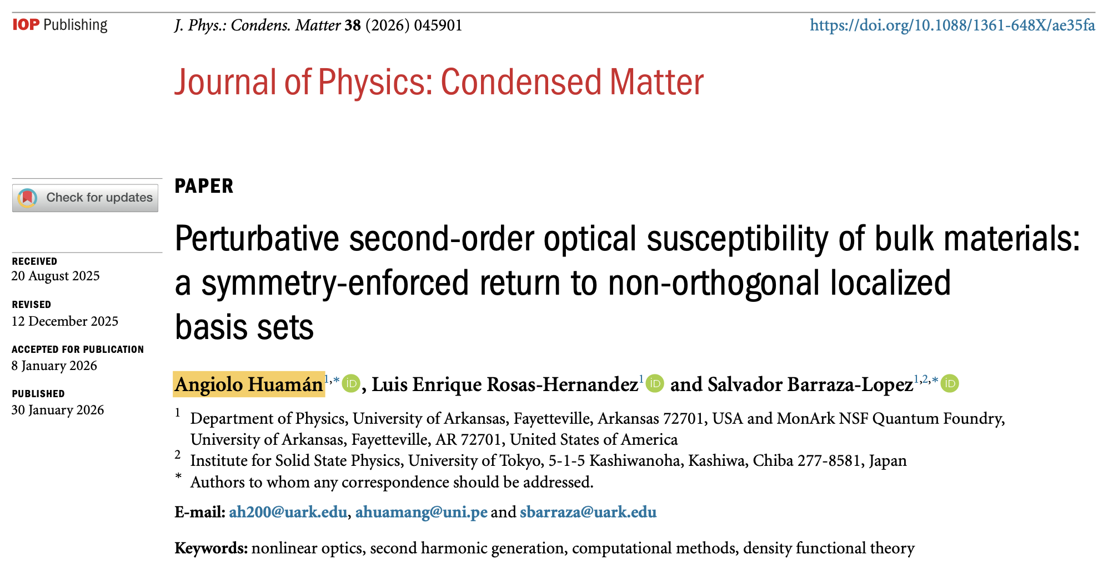

Slide 3
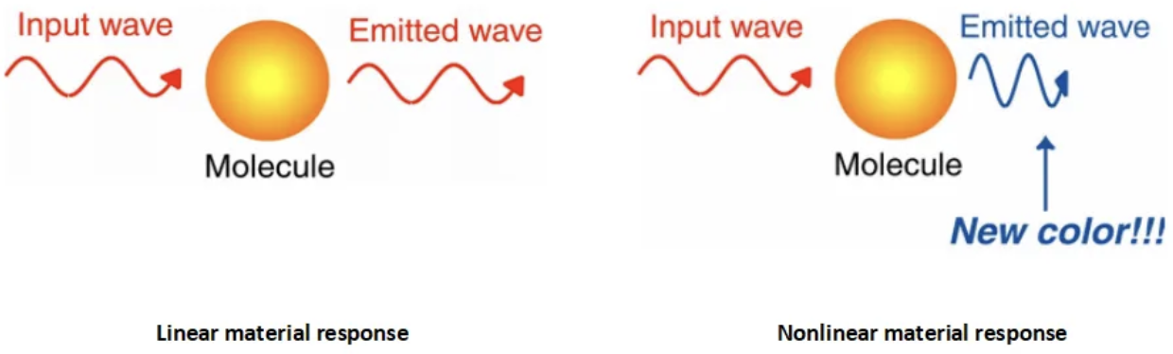
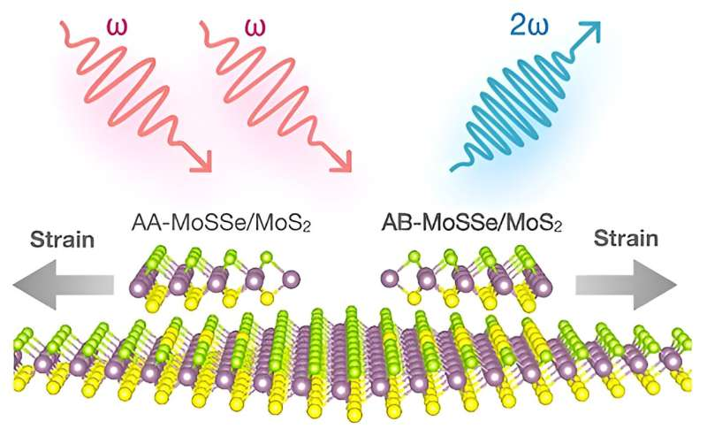
Linear and nonlinear optical responses:
Second harmonic
generation
Typical of materials
without an inversion center.

Slide 4

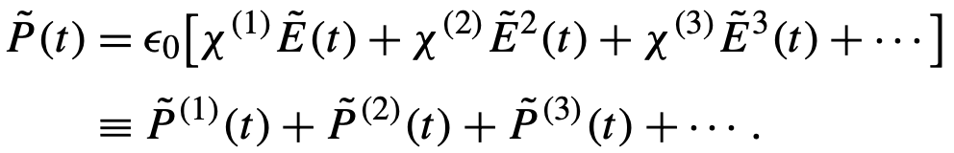
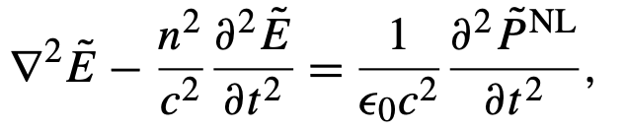
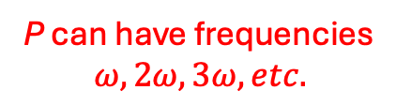

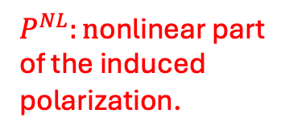
Nonlinear optical response: Phenomenology
Linear dependence between P and E.
If E has a frequency $ω$, so does P.
General nonlinear case: The induced polarization can be written as a “Taylor” series on the electric field:
P can have frequencies
$$ω, 2ω, 3ω, etc.$$
The nonlinear (NL) polarization acts as a source of electromagnetic waves:
$P^{NL}:n$onlinear part
of the induced
polarization.

Slide 5
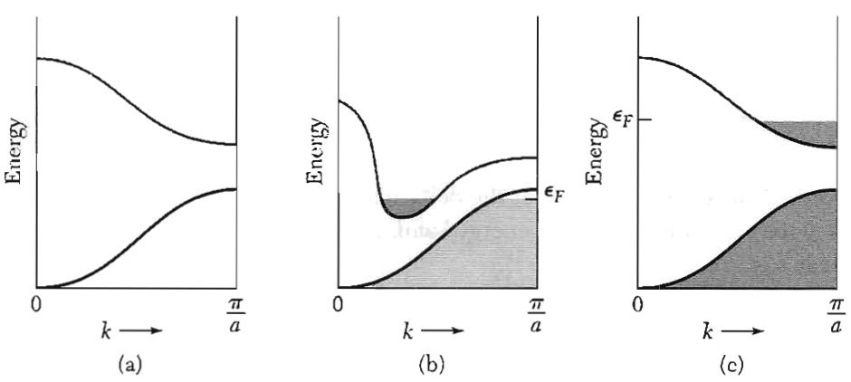
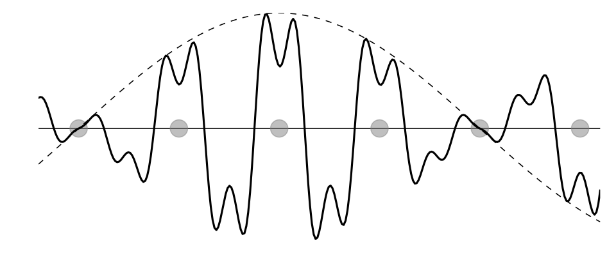
Microscopic (quantum mechanical) theory of the nonlinear optical susceptibility
The key ingredients for a quantum mechanical description of the optical susceptibility of a semiconductor:
  The wavefunctions or eigenstates: Bloch waves.
  The eigenenergy: Energy bands.
  Both the eigenstates and eigenfunctions are indexed by a k-number and a band index.

Slide 6
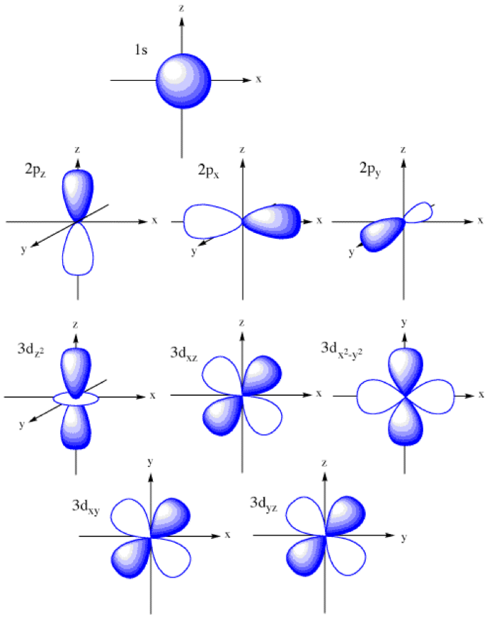
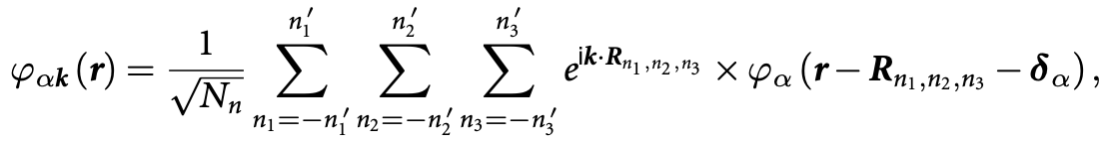
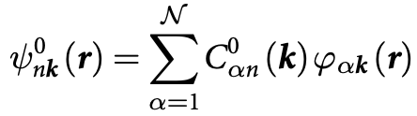

How to get Bloch eigenstates and energy bands: Density Functional Theory (DFT) !
It allows to determine the Bloch eigenstates and energy bands in a material (semiconductor) self consistently.
There are many DFT implementations (codes).
We used SIESTA, which writes the Bloch eigenstates as combinations of pseudo atomic orbitals (PAOs):
The final Bloch eigenstates come from a generalized eigenvalue problem:

Slide 7

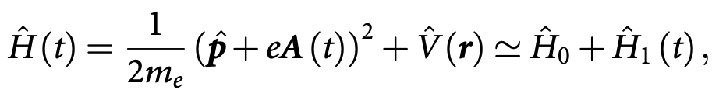

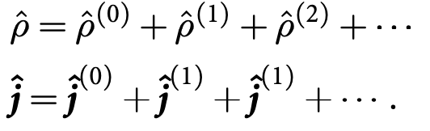
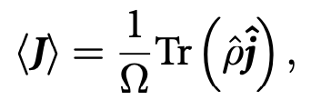


Independent Particle Approximation (IPA):
Crystal Hamiltonian:
Light-matter coupling term (velocity gauge):
The induced polarization is obtained by calculating the density matrix
in a perturbative way and from it the macroscopic current:
Expansions up to second order in $H_{1}.$

Slide 8
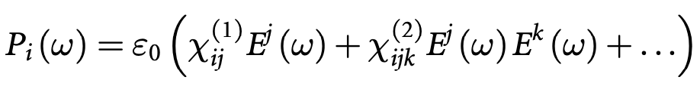
Linear and quadratic optical susceptibility:
Linear: symmetric
tensor of rank 2
Quadratic: tensor
of rank 3 symmetric
in its last two indices

Slide 9
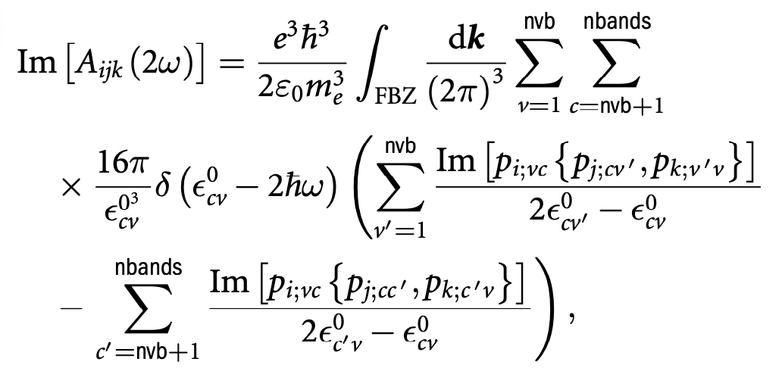
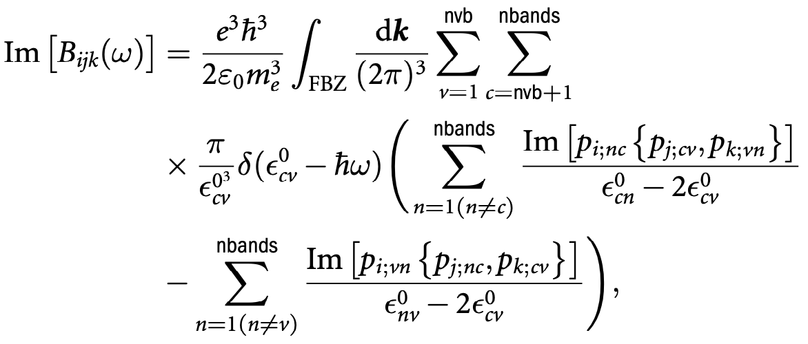
The matrix elements of the momentum
operators between Bloch eigenstates
are calculated exploiting the symmetries
of the PAOs. This reduces the computational
effort.
The optical response (at the IPA level)
is written in terms of the single body Bloch
wavefunctions and energy bands.

Slide 10


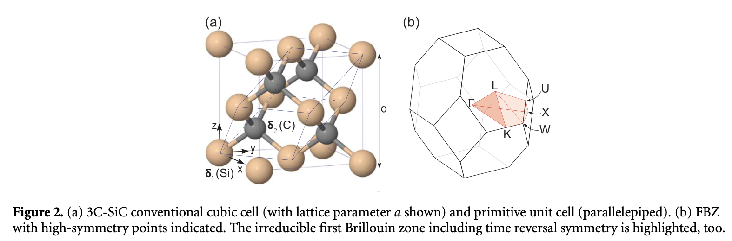
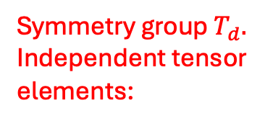
Application to cubic silicon carbide (3C-SiC):
Symmetry group $T_{d}.$
Independent tensor
elements:

Slide 11
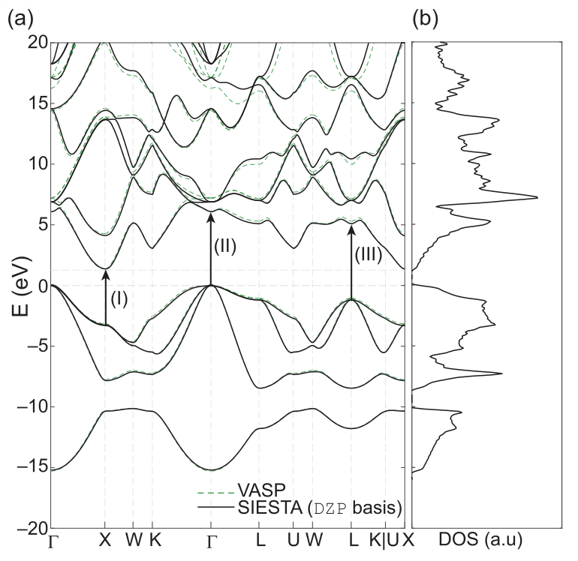
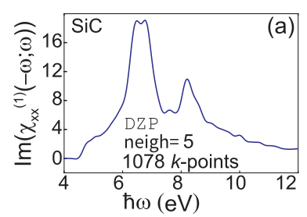
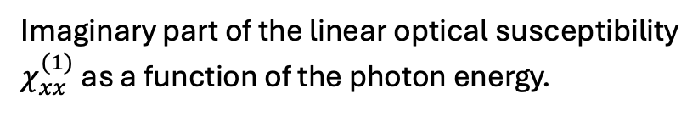
Imaginary part of the linear optical susceptibility
$χ_{xx}^{(1)}$ as a function of the photon energy.
Energy bands along a high symmetry path in the FBZ.
All other entries are zero.

Slide 12
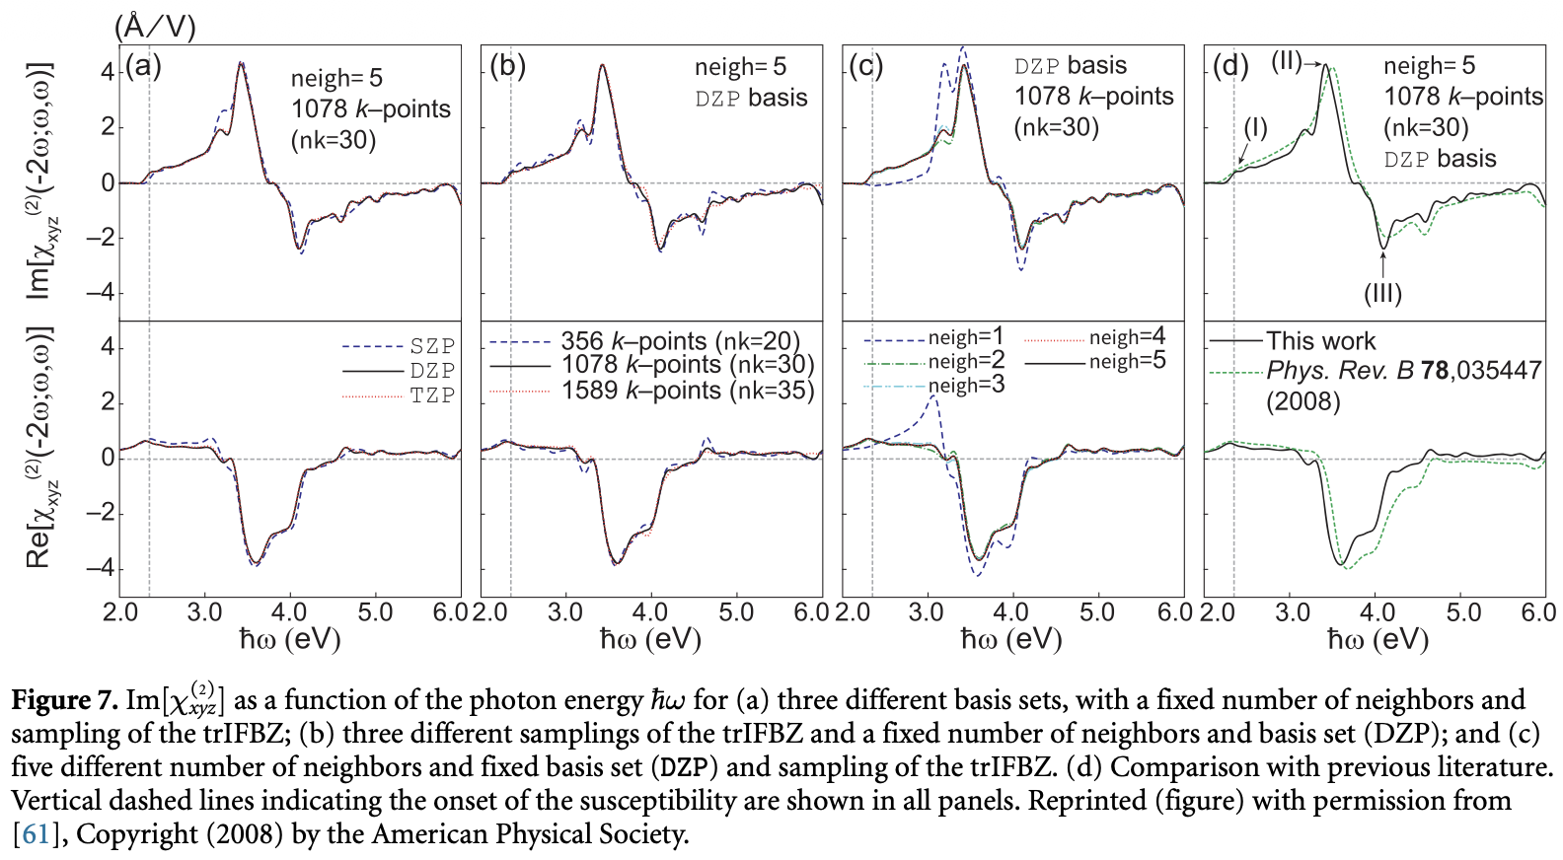
Comparison with
the literature
FBZ sampling

Slide 13
Thank you for listening !

