Slide 1
Statistical Effect in the Parton Distribution Functions of the Nucleon
Yunhua Zhang, Lijing Shao, Bo-Qiang Ma
School of Physics and State Key Laboratory of Nuclear Physics and Technology, Peking University
Journal Club UNI Física de Partículas: Sesión 0
Jorge Benel, Junior Alegre

Slide 2
Motivation - Introduction – Objective – Methodology – Results - Conclusions

Slide 3
Motivation - Introduction – Objective – Methodology – Results - Conclusions

Slide 4
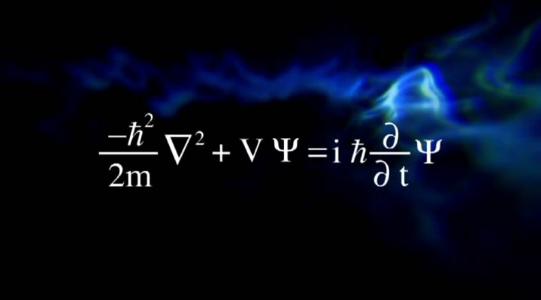
Motivation - Introduction – Objective – Methodology – Results - Conclusions

Slide 5
Motivation - Introduction – Objective – Methodology – Results - Conclusions

Slide 6
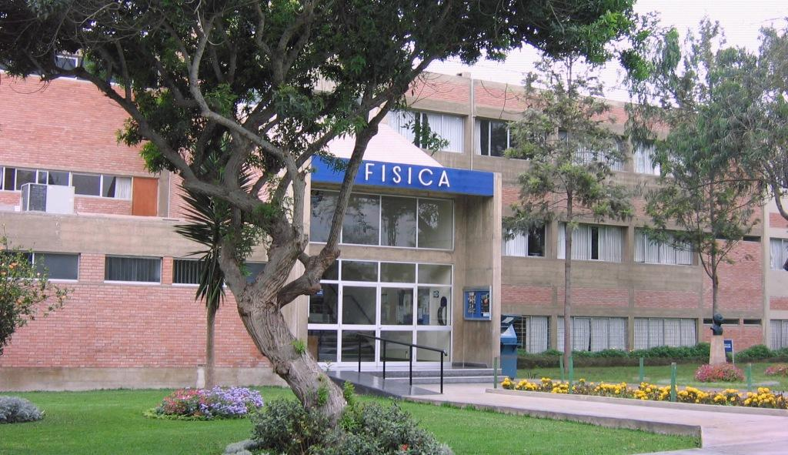
Motivation - Introduction – Objective – Methodology – Results - Conclusions

Slide 7
Motivation - Introduction – Objective – Methodology – Results - Conclusions

Slide 8
Motivation - Introduction – Objective – Methodology – Results - Conclusions

Slide 9
Motivation - Introduction – Objective – Methodology – Results - Conclusions

Slide 10
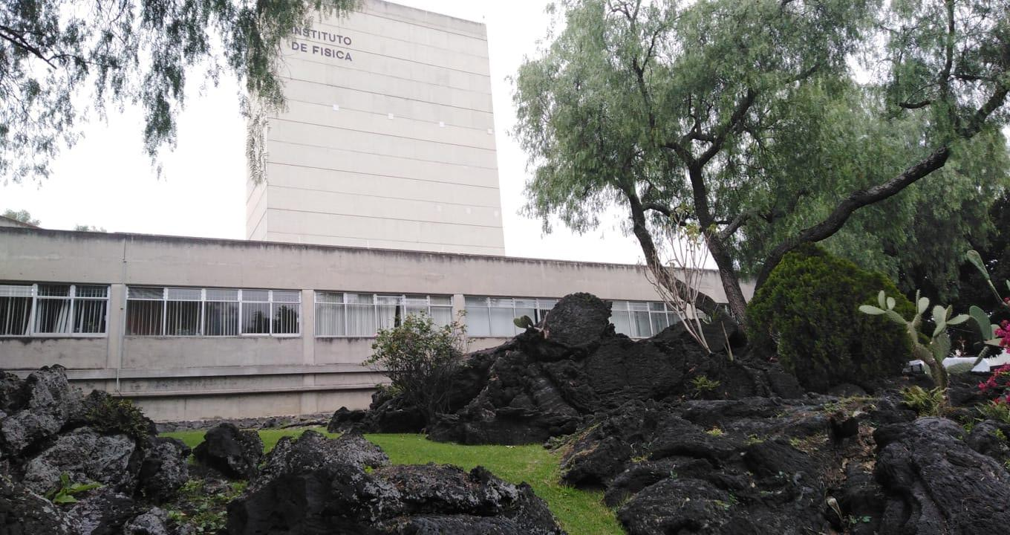
Motivation - Introduction – Objective – Methodology – Results - Conclusions

Slide 11
Motivation - Introduction – Objective – Methodology – Results - Conclusions

Slide 12
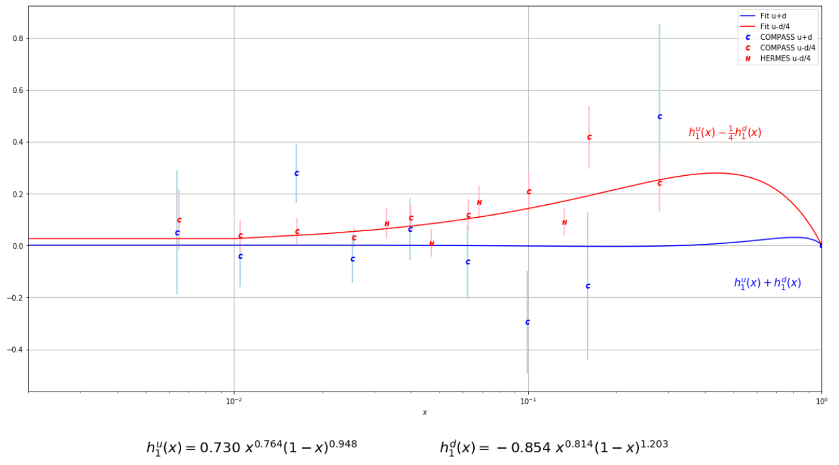
Motivation - Introduction – Objective – Methodology – Results - Conclusions

Slide 13
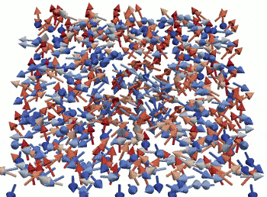
Motivation - Introduction – Objective – Methodology – Results - Conclusions

Slide 14
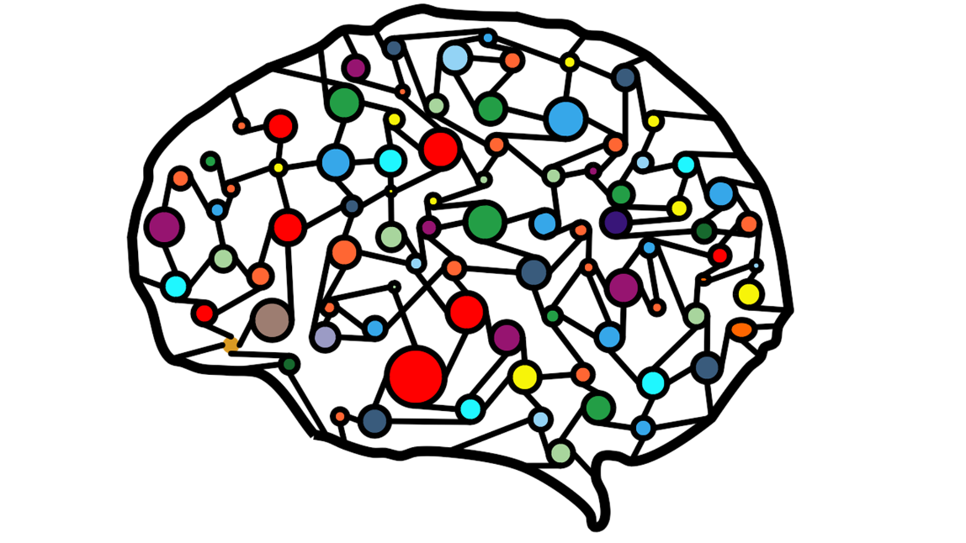
Motivation - Introduction – Objective – Methodology – Results - Conclusions
ESTADO DEL ARTE ?

Slide 15
Motivation - Introduction – Objective – Methodology – Results - Conclusions
ESTADO DEL ARTE
KEYWORDS
Statistical Model
Parton Distribution Functions
Nucleon Structure
Light-Front Formalism

Slide 16
Motivation - Introduction – Objective – Methodology – Results - Conclusions
Statistical Model

Slide 17
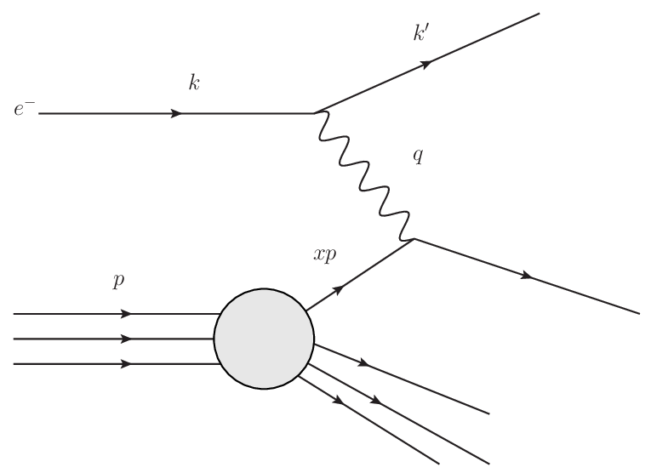
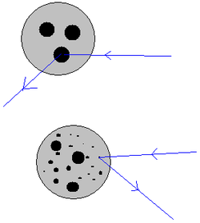
Motivation - Introduction – Objective – Methodology – Results - Conclusions
Nucleon Structure

Slide 18
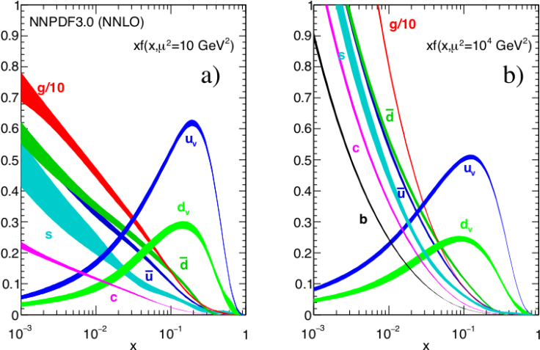
Motivation - Introduction – Objective – Methodology – Results - Conclusions
Parton Distribution Functions

Slide 19
Motivation - Introduction – Objective – Methodology – Results - Conclusions
To apply a simple statistical approach to calculate the parton distribution functions (PDFs) of the nucleon

Slide 20
Motivation - Introduction – Objective – Methodology – Results - Conclusions
To apply a simple statistical approach to calculate the parton distribution functions (PDFs) of the nucleon
Aplicar un enfoque estadístico simple para calcular las funciones de distribución de partones (PDFs) del nucleón

Slide 21
Motivation - Introduction – Objective – Methodology – Results - Conclusions
Suponer que el nucleón es un sistema térmico en equilibrio

Slide 22
Motivation - Introduction – Objective – Methodology – Results - Conclusions
Cambiamos de SR al de light-cone coordinates

Slide 23
Motivation - Introduction – Objective – Methodology – Results - Conclusions
Cambiamos de SR al de light-cone coordinates

Slide 24
Motivation - Introduction – Objective – Methodology – Results - Conclusions
Aplicamos una condición on-shell
$$E_{f}=\sqrt{{\overline{k}}^{2}+m_{f}^{2}} ; \overline{k}=(k^{1},k^{2},k^{3})$$

Slide 25
Motivation - Introduction – Objective – Methodology – Results - Conclusions
Aplicamos una condición on-shell
$$E_{f}=\sqrt{{\overline{k}}^{2}+m_{f}^{2}} ; \overline{k}=\left(k^{1},k^{2},k^{3}\right)$$
$$k^{0}=\sqrt{{\overline{k}}^{2}+m_{f}^{2}}$$

Slide 26
Motivation - Introduction – Objective – Methodology – Results - Conclusions
Cambio de SR + condición on-shell

Slide 27
Motivation - Introduction – Objective – Methodology – Results - Conclusions
Integrando, suponiendo que es isotrópico en k⟂
*

Slide 28
Motivation - Introduction – Objective – Methodology – Results - Conclusions
Se obtiene finalmente,

Slide 29
Motivation - Introduction – Objective – Methodology – Results - Conclusions
Se obtiene finalmente,

Slide 30
Motivation - Introduction – Objective – Methodology – Results - Conclusions
The statistical effect is not everything, but it is very important to some aspects of the nucleon structure

Slide 31
Motivation - Introduction – Objective – Methodology – Results - Conclusions
The statistical effect is not everything, but it is very important to some aspects of the nucleon structure
El efecto estadístico no lo es todo, pero es muy importante para algunos aspectos de la estructura del nucleón.

