Slide 1
XIX MEETING OF PHYSICS
URBAN ARCHAEO-GEOPHYSICS A CHALLENGE FOR THE SUSTAINABLE DEVELOPMENT OF OUR TOWNS.
THE CASE OF CUSCO IN PERU
MSC: David Vera Victoria
24 September 2020, UNI
LIMA-PERU

Slide 2
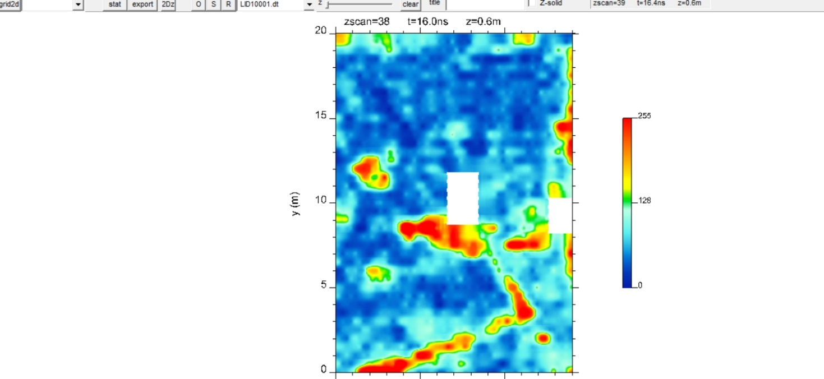
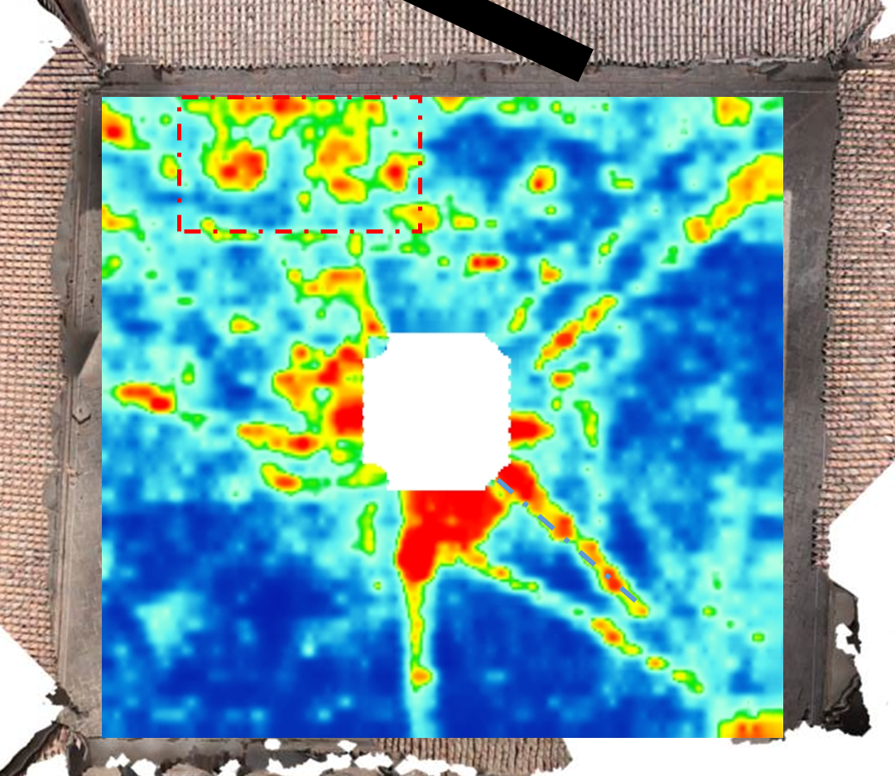
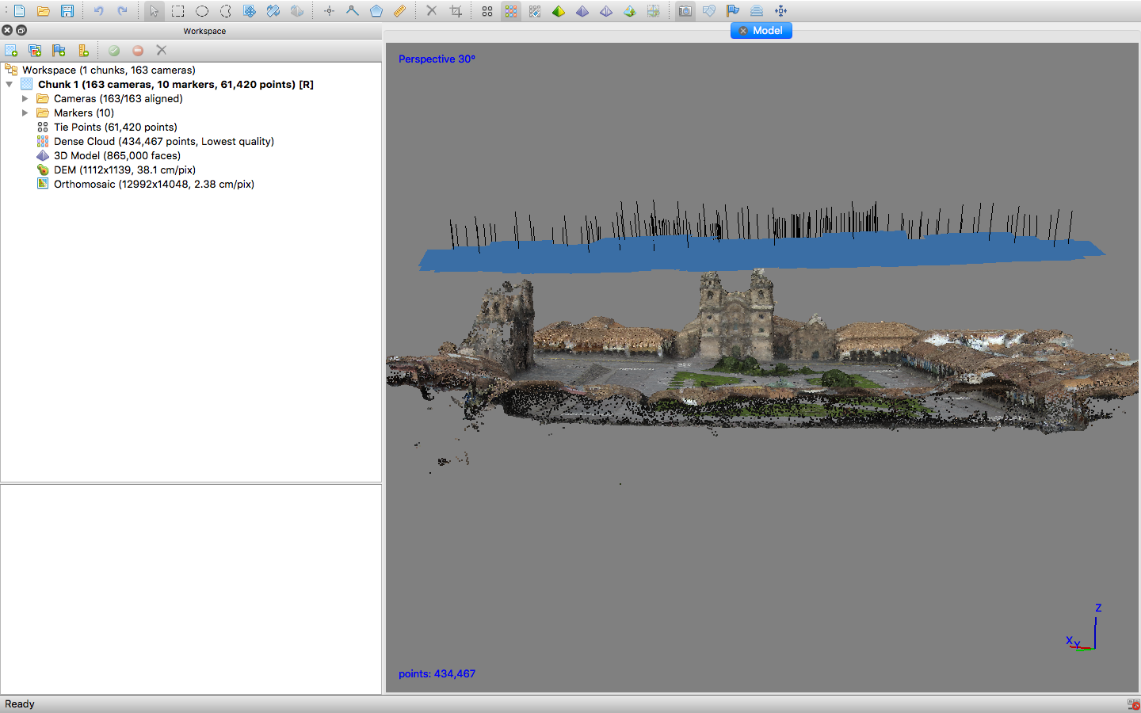
URBAN ARCHAEO-GEOPHYSICS A CHALLENGE FOR THE SUSTAINABLE DEVELOPMENT OF OUR TOWNS. THE CASE OF CUSCO IN PERU
David Vera Victoria
Responsable de PI
Prof. Principal UNSAAC - Cusco
Sayri Garcia
Integrante de PI
Prof. Principal UNSAAC - Cusco
Nicola MASINI
Director de Investigacion del CNR-ISPC – Italia
Responsable del Instituto de Ciencias (ISPC) por el Patrimonio Culturale, sede de Potenza, Italia
Rosa LASAPONARA
Director de Investigacion del CNR-IMAA, Potenza– Italia
Maria SILEO
Investigadora del CNR-ISPC, Potenza – Italia

Slide 3
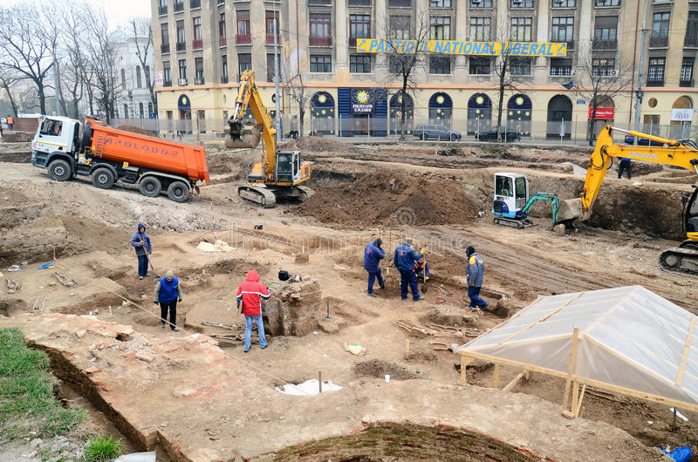
Urban Archeology
Urban archeology represents a fundamental tool for the study of cities in their formal and functional evolution and the sustainable management of urban development that also includes the protection and improvement of cultural heritage.

Slide 4
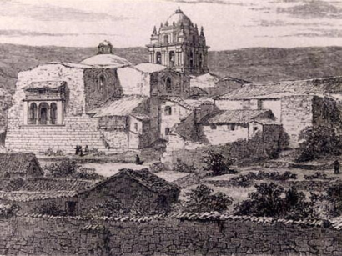
Urban Archeology
An important part of this cultural heritage is conserved underground, which in cities like Cusco constitutes a treasure waiting to be detected and revealed.

Slide 5
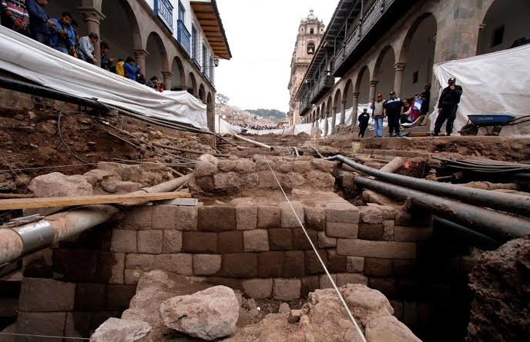
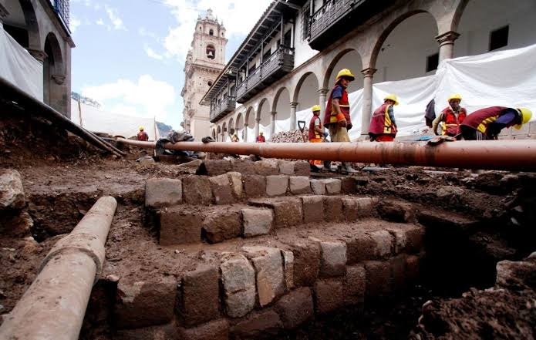
Urban Archeology
in Cusco
This is particularly observed when the needs of modernity make it necessary to continuously improve technological networks and infrastructures, part of which are underground, interfering and sometimes damaging vestiges of the ancient past.

Slide 6
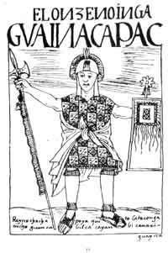
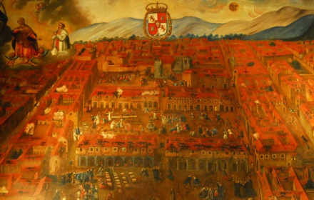
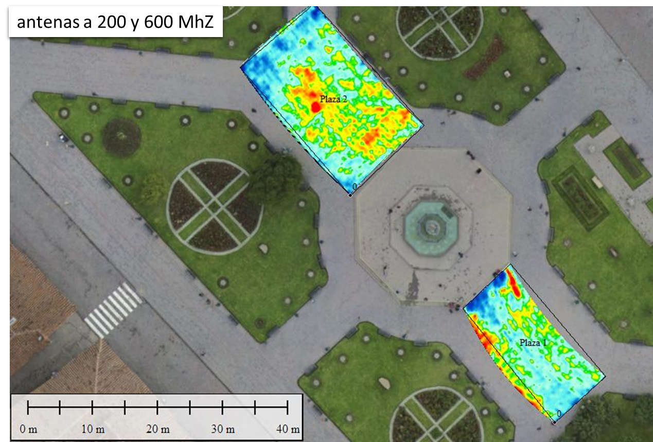

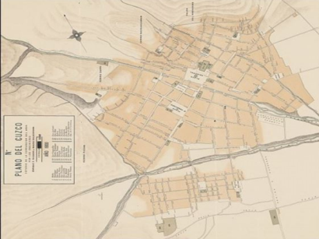
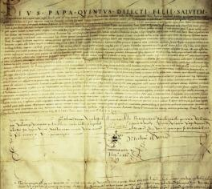
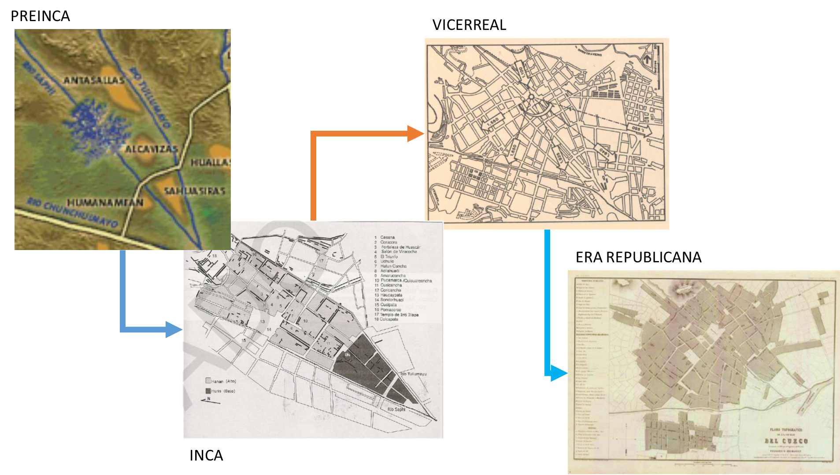
Methodological approach
Geophysics
Chronicles
Historical iconography
Interpretation
Arqueology
Historical Document
Historical Cartography

Slide 7
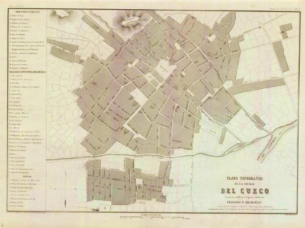
Historical urban growth: Republican Cusco
From 1940 it is appreciated an urban expansion in Cusco.
Carrying out new road works, widening and paving streets.
Sanitation works, canalization in some sections of the Huatanay, Shapy and Tullumayo rivers, Puente Rosario.

Slide 8
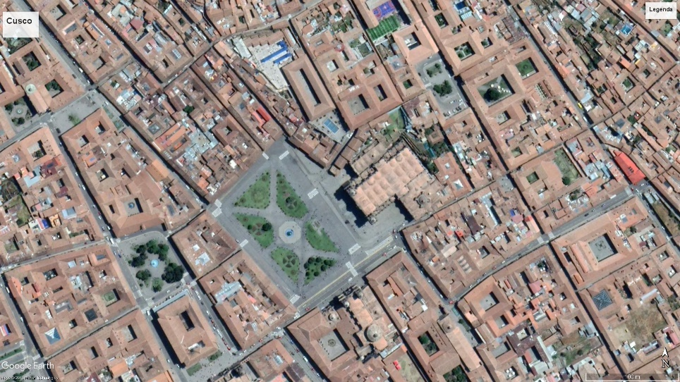
Growth Periods of Plaza de Armas del Cusco
Republican period
Incas period
Colonial period
XXI century

Slide 9
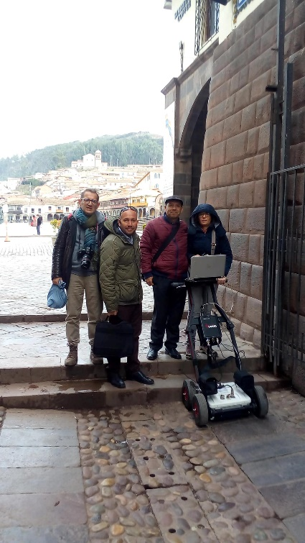
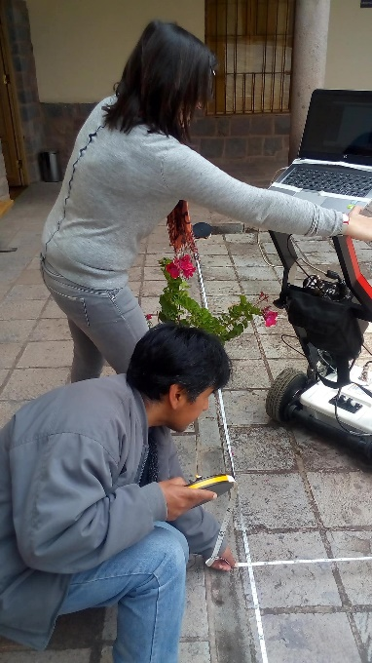
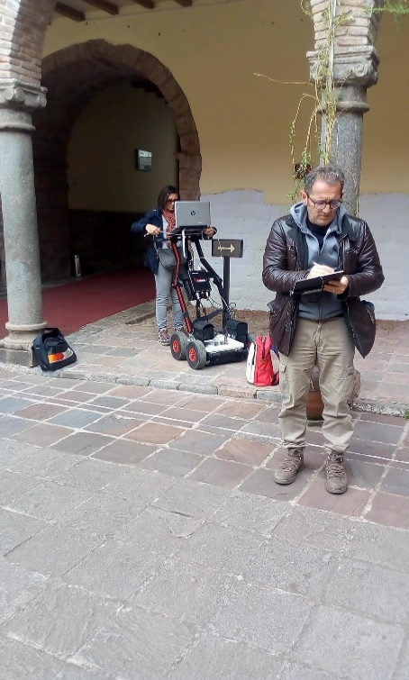
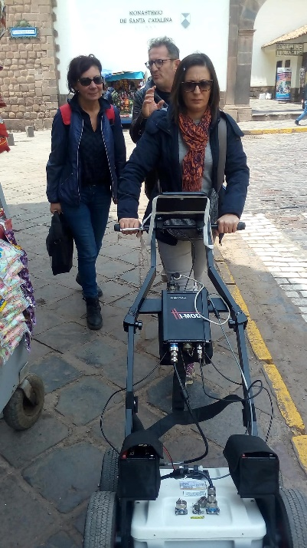
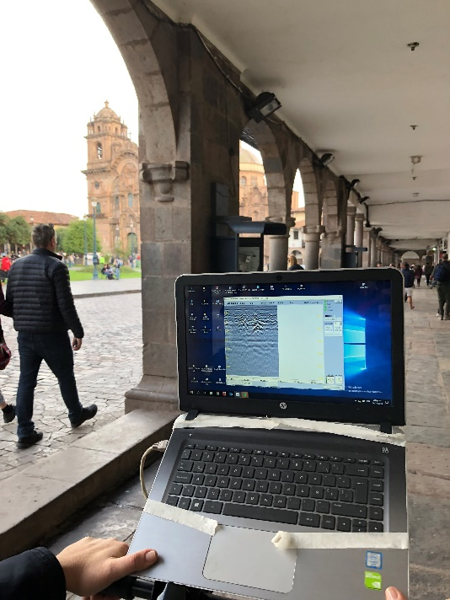
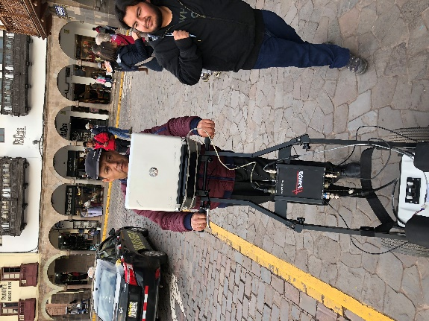
Cooperation project: UNSAAC - CNR Italia

Slide 10

Investigated Areas
Investigated areas:
Paraninfo, central area, 64 x 40 profiles between longitudinal and transversal
Plaza 1, area 10m x 23m, 25 longitudinal profiles
Plaza 2 , area 25m x 15m, 80 longitudinal profiles
Casa Concha central area, 15m x 25m, 90 profiles longitudinal and transversal
Portales Plaza de armas, 32 profiles longitudinal
Calle Loreto, 37 profiles longitudinal and trasversal
Rectorado, central area 12m x 8m, 40 profiles longitudinal and trasversal
Rectorado
Portales
Plaza de Armas
Casa Concha
Paraninfo-Loreto

Slide 11
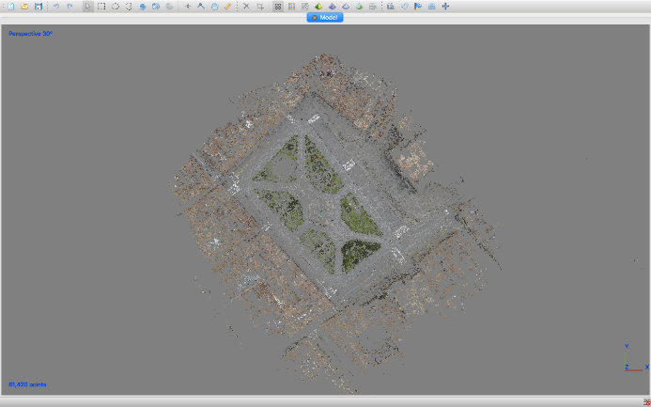
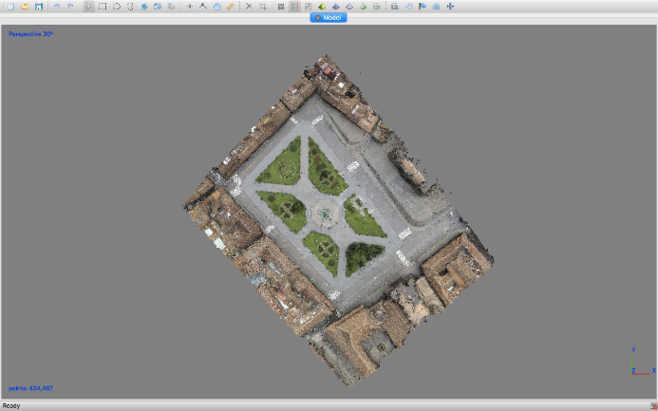
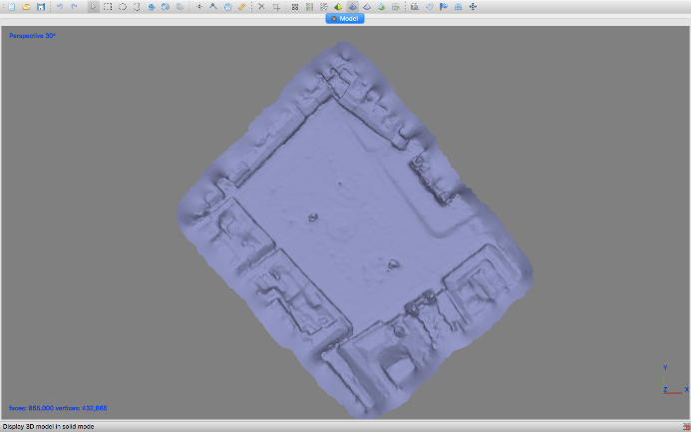
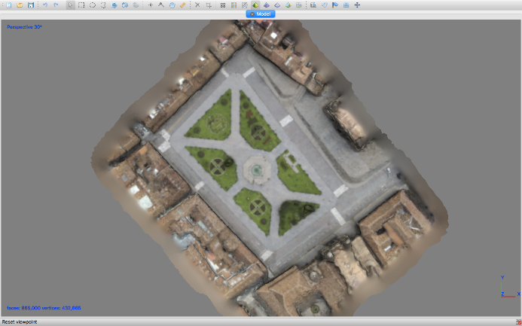
WORKFLOW 3D MODEL
First step: map and 3D model of the Plaza de Armas del Cusco
Point cloud Dense point cloud Mesh 3d Model
Point cloud

Slide 12
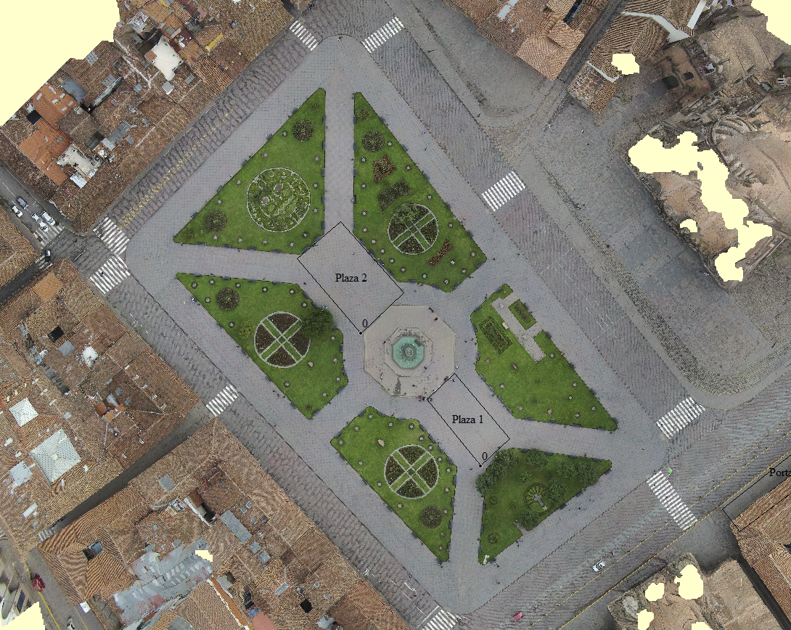
Plaza de Armas del Cusco
Plaza de armas

Slide 13
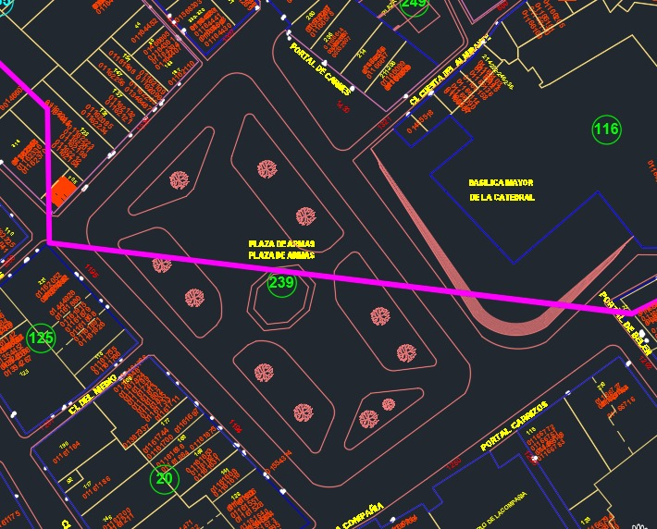
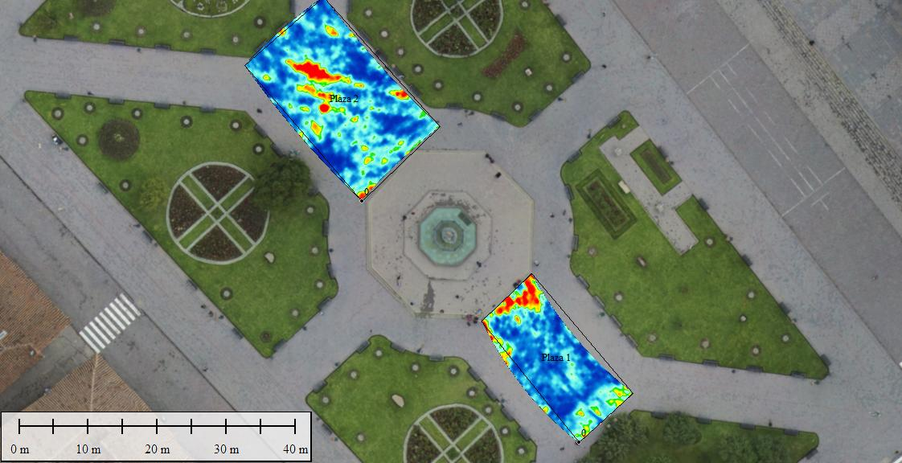
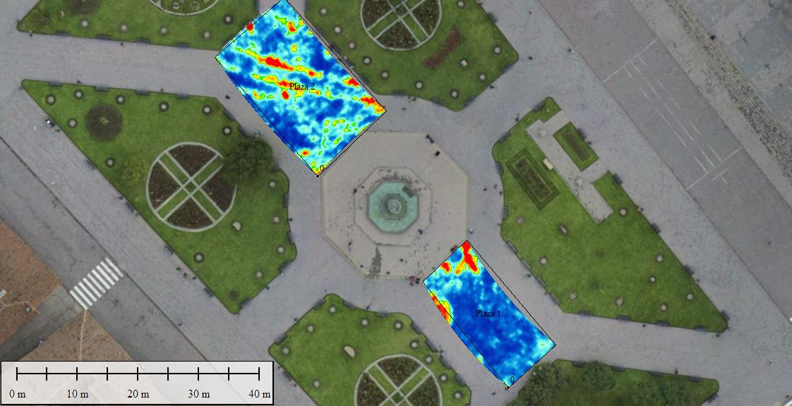
Plaza de Armas del Cusco: georadar maps at 60cm deep
antenas a 200 y 600 MhZ
Water pipes
estructure
Map of the underground services of Cusco
estructure

Slide 14
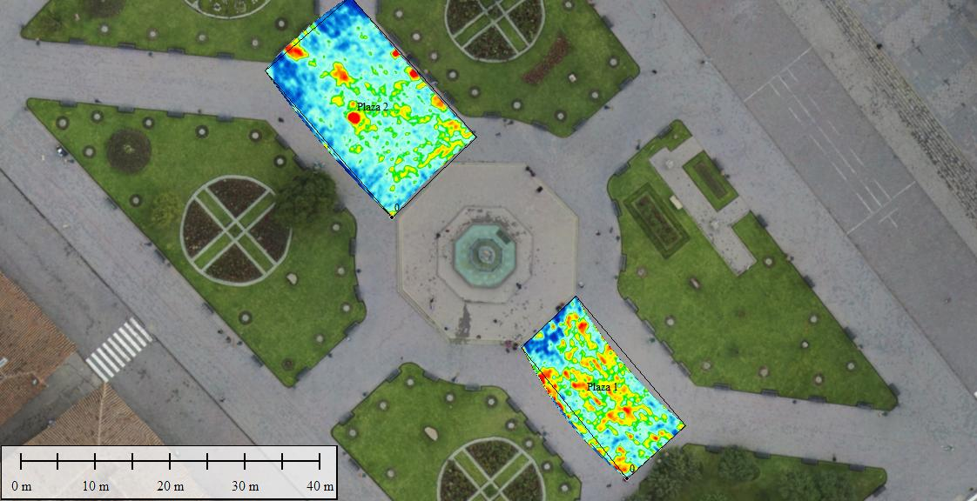
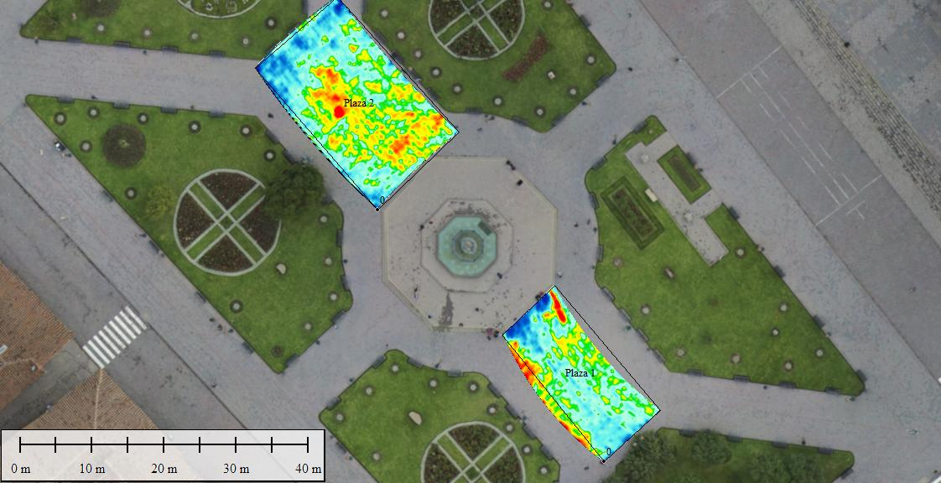
Plaza de Armas: georadar maps at 120cm deep
antenas a 200 y 600 MhZ

Slide 15
Plaza de Armas: mapas georadar a 60cm y 120 cm de profundidad
aqueducto
Muros?
Muros?
Muros?
60cm
120cm

Slide 16
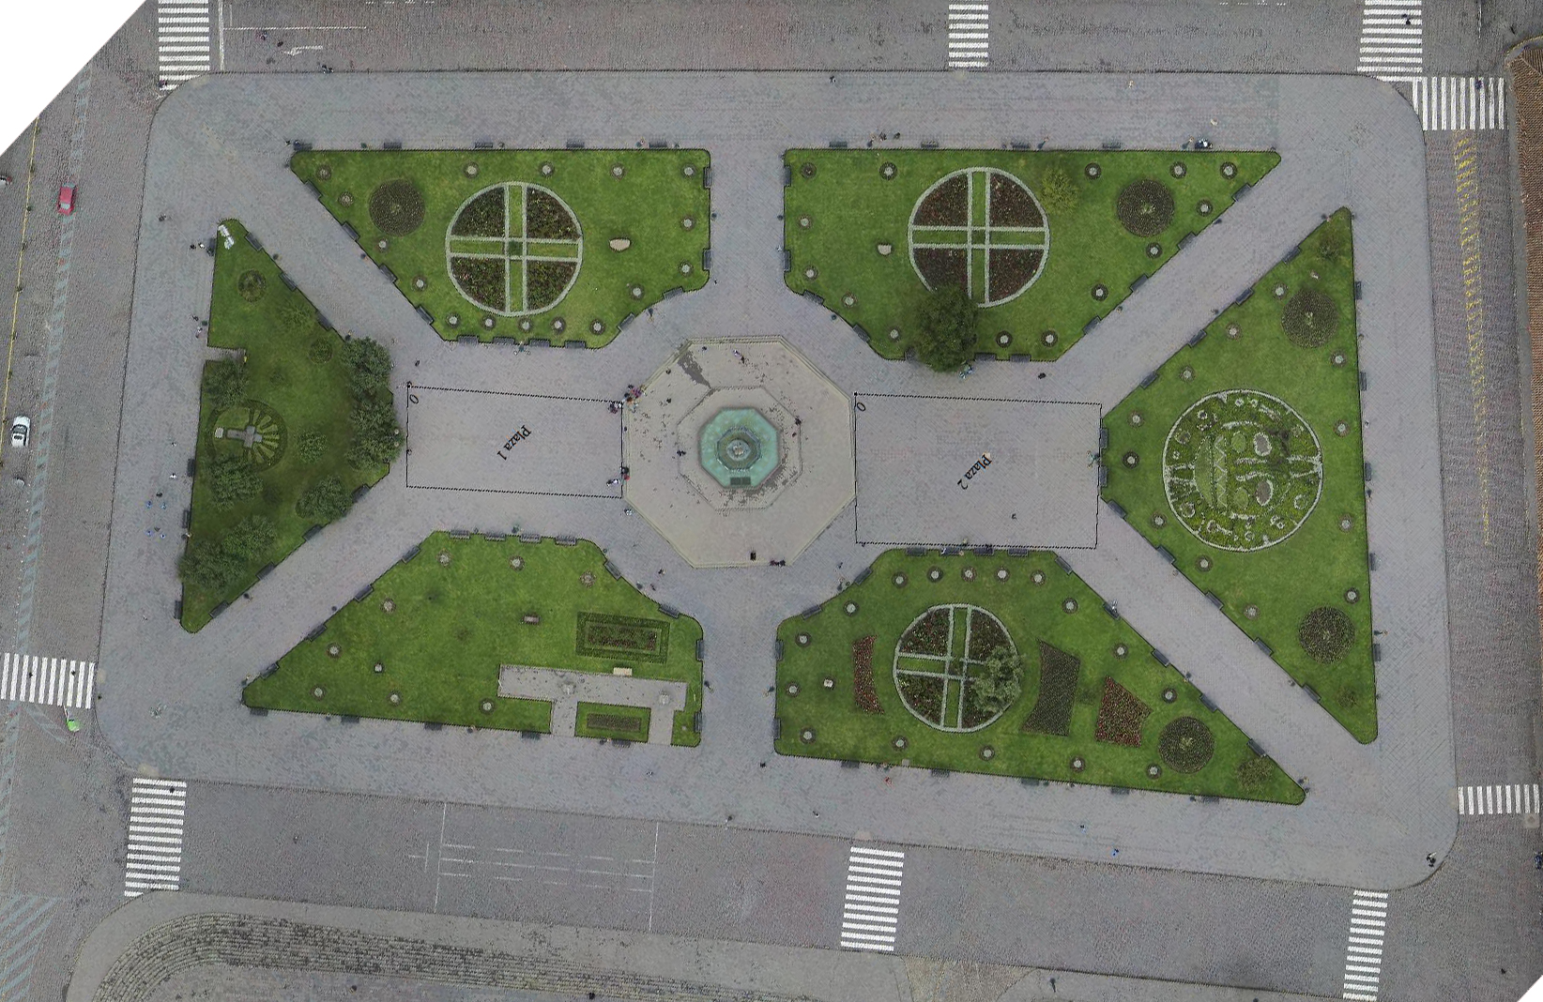
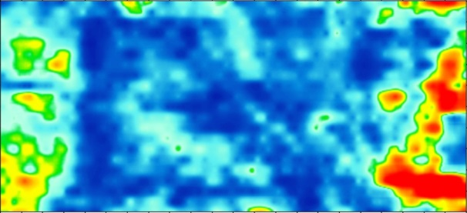
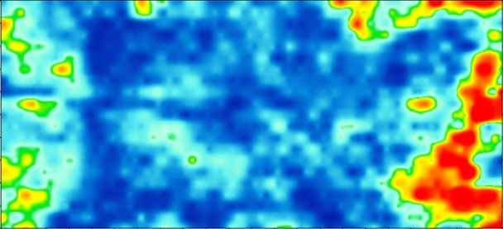
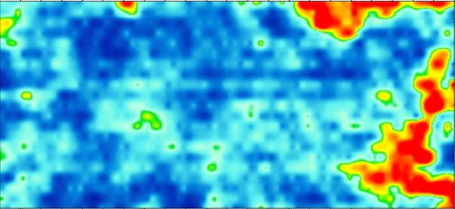
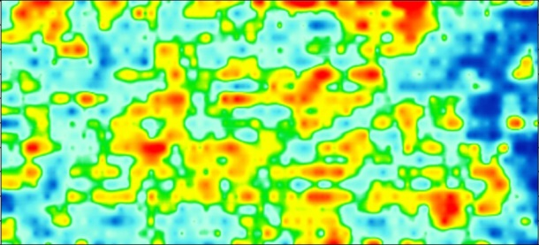
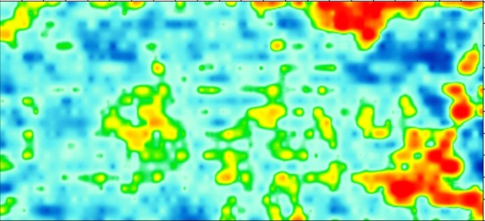
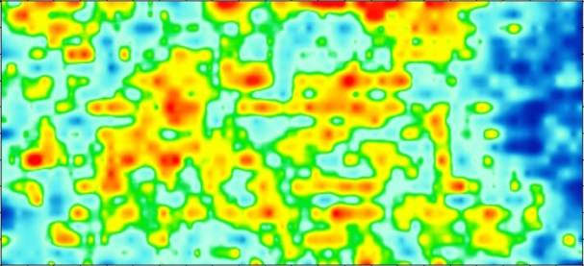
Plaza de Armas: georadar maps - details
Plaza_1 GPR 200 Mhz
GPR 200_ 0,4 m
Plaza de armas
GPR 200_ 0,6 m
GPR 200_ 1,2 m
GPR 200_ 0,8 m
GPR 200_ 1 m
GPR 200_ 1,4 m

Slide 17
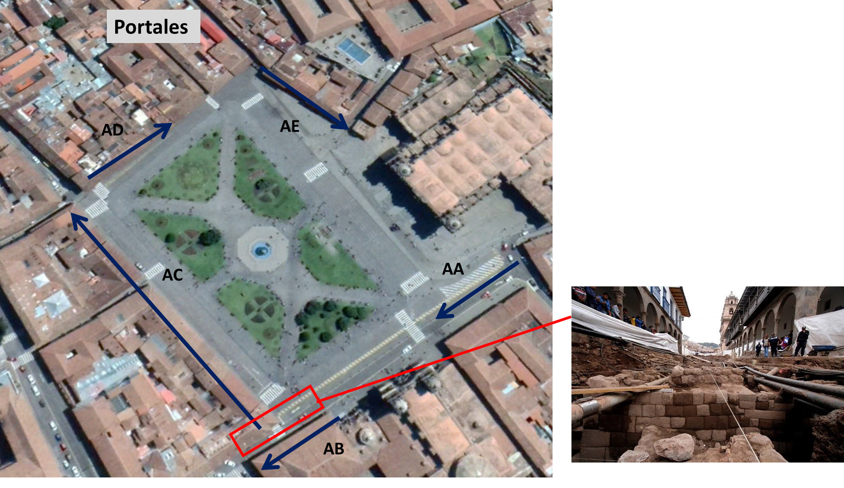
Portales de la Plaza de Armas
Mantas street excavations in 2014

Slide 18
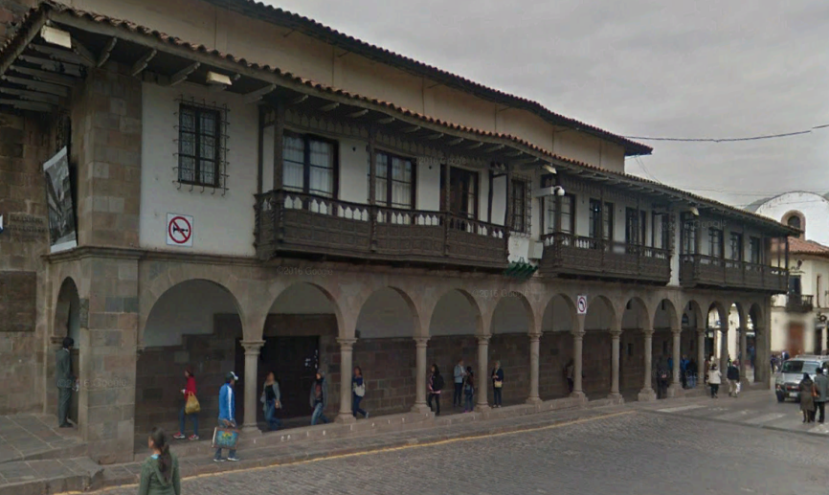
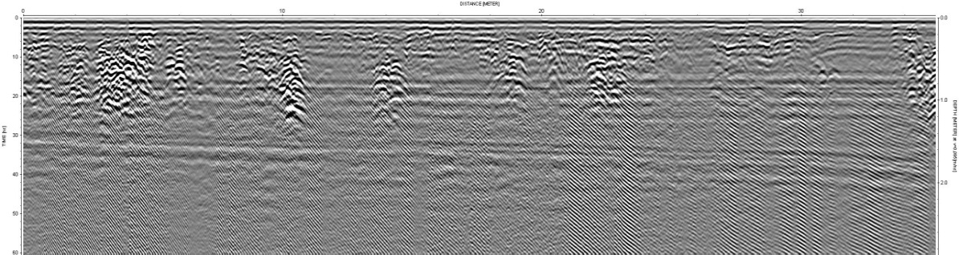

verification of the continuity of archaeological structures
Portales de la Plaza de Armas – Portal Compania: prospeting AB
Verification of the continuity of archaeological estructures in Portal Carrizos
Portales_AB
600_2
600_3

Slide 19
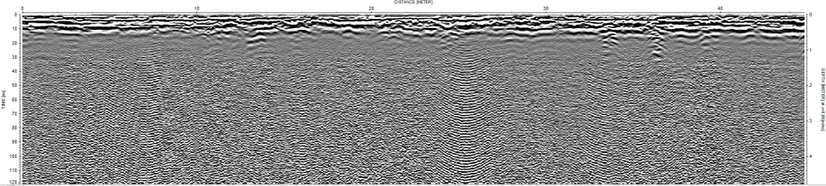
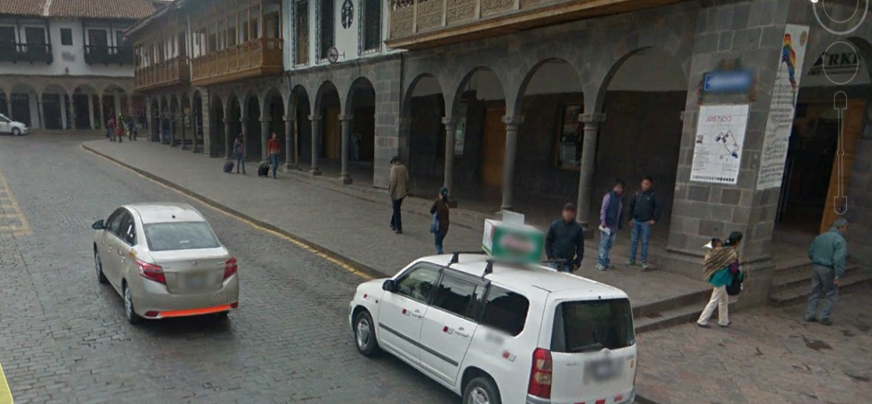
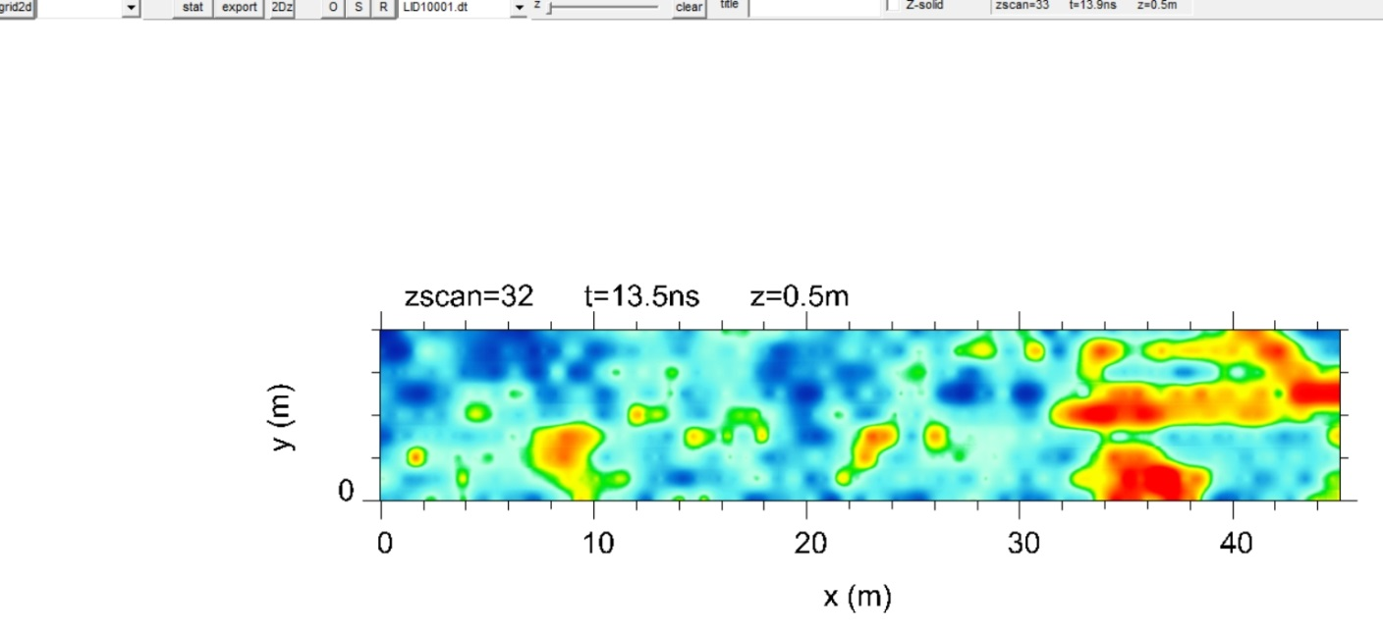
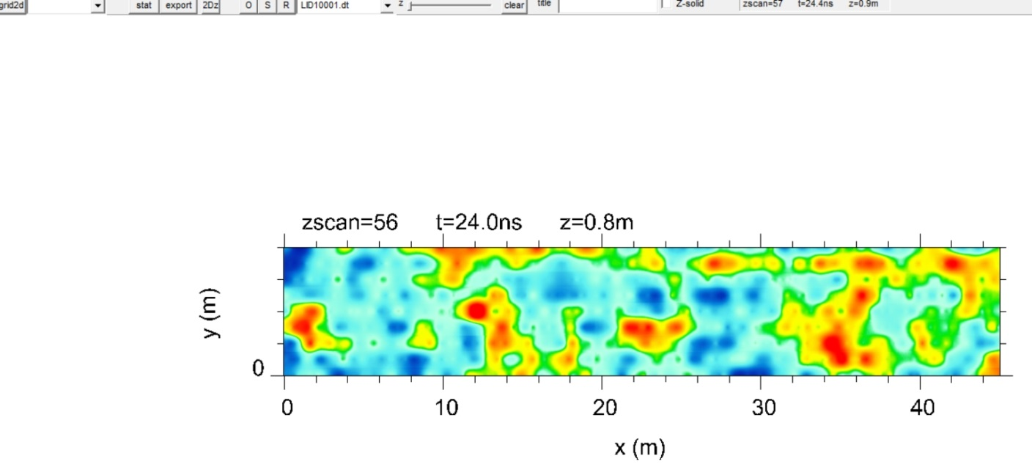
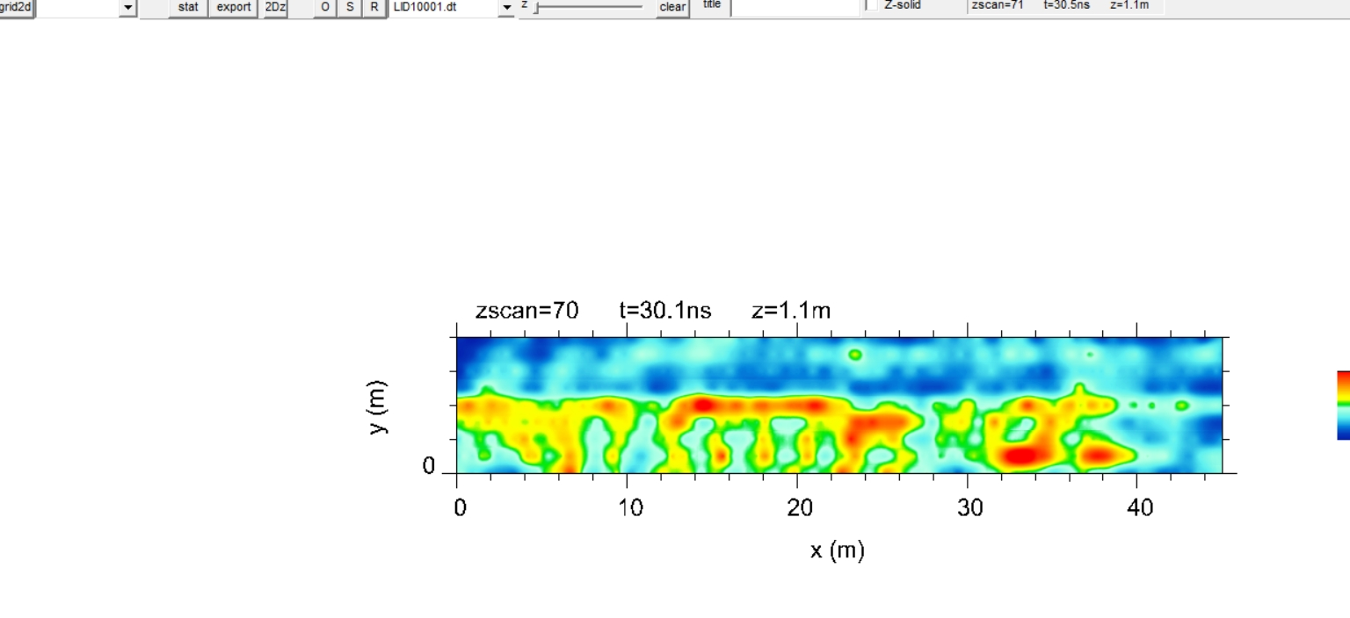
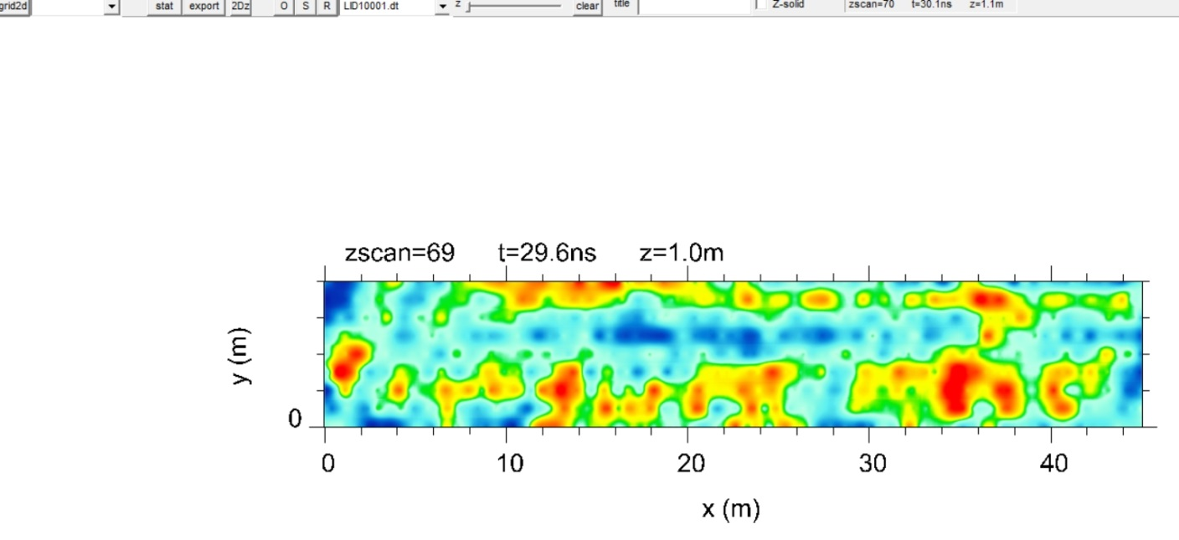
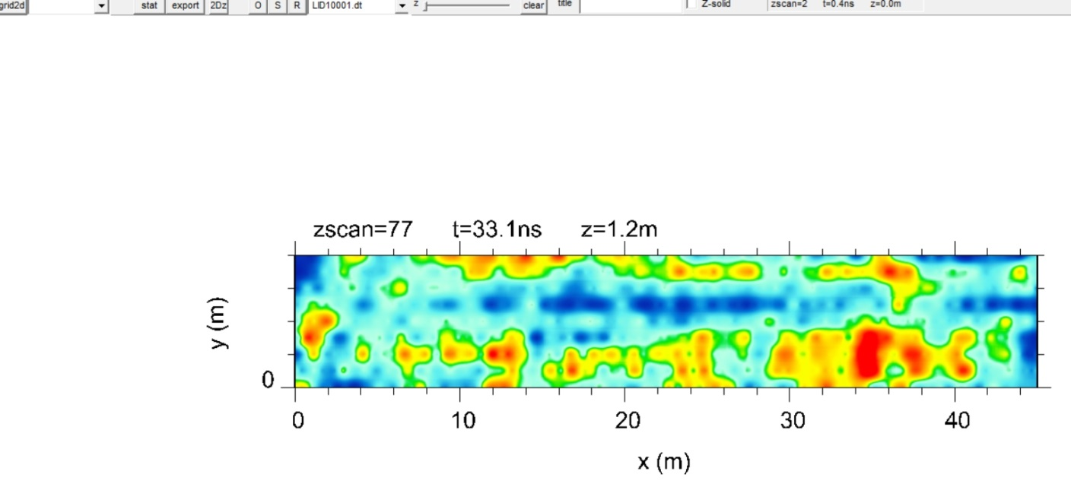
Portales de la Plaza de Armas – Portal Belen y Carrizos: prospecciones AA
Portales_AA_200 Mhz
Portales_AA GPR200Mhz 0,5m
Portales_AA GPR200Mhz 0,8m
Portales_AA GPR600Mhz 1,1m
Portales_AA GPR200Mhz 1,0m
Portales_AA GPR200Mhz 1,2m

Slide 20
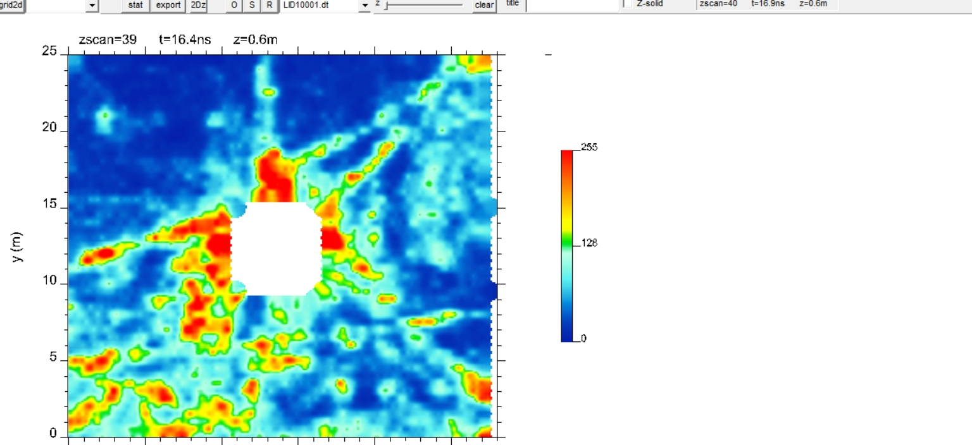
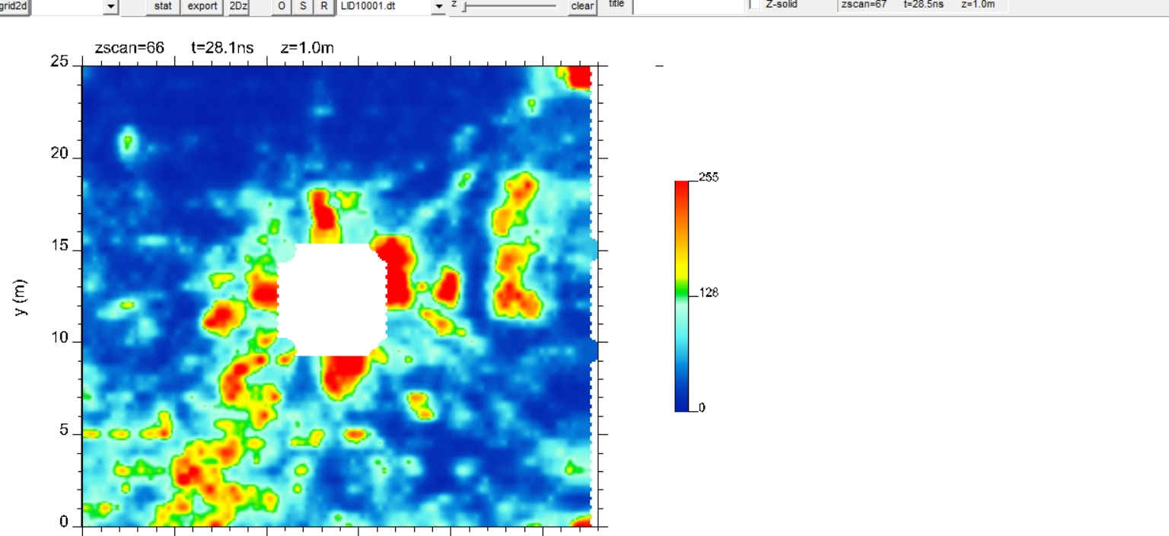



GPR 600_ 0,6 m
GPR 600_ 1 m
PARANINFO
N
Paraninfo
19
18
1
0
47
32
pipes
27,5m
estructures
GPR 600_ 0,8 m
GPR 600_ 1,2 m
46
33
2
GPR 600_ 0,42 m
estructures

Slide 21

N
Paraninfo
PARANINFO
120cm of deep
60cm de profundidad

Slide 22








RECTORADO
GPR 600_0,4m
GPR 600_0,8 m
GPR 600_1 m
GPR 200_1,2 m
GPR 200_1,6 m

Slide 23

CASA CONCHA

Slide 24







CASA CONCHA
GPR 600_ 0,6 m
GPR 200_ 2 m
GPR 600_ 0,2 m
600_1
600_26
600_15
600_16

Slide 25
CASA CONCHA
600_1
600_26
600_15
600_16

Slide 26

Thanks for your attention

