Slide 1
Effects of size, shape and structure on the Curie temperature of Fe and Ni nanoparticles
A. Terrazas Palomino, G. Cuba-Supanta, J. Gomez Quispe, T. Milla, R. Espinoza,
J. Rojas Tapia, C. Rojas Ayala. Grupo de métodos computacionales aplicados a nanomateriales GMCAN -
Universidad Nacional Mayor de San Marcos UNMSM. angel.terrazas@unmsm.edu.pe

Slide 2
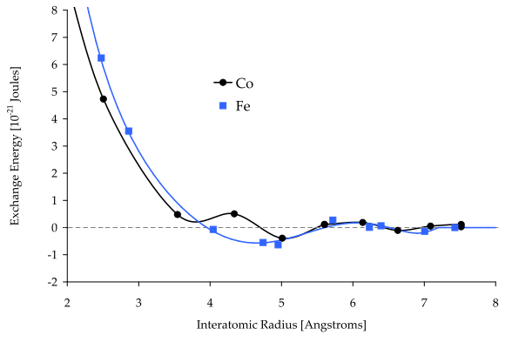
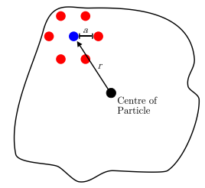
Modelling methods
The atomic structures of small Fe and Ni nanoparticles are simulated using molecular dynamics. The magnetic properties are simulated using a spin classical Hamiltonian:
The time evolution of magnetization is calculated using the numerical solution of the Landau Liftshitz-Gilbert equation and the Langevin dynamics:
R. Francis and L. Evans, “ATOMISTIC MODELLING OF NANOGRANULAR MAGNETIC MATERIALS,” 2008.

Slide 3
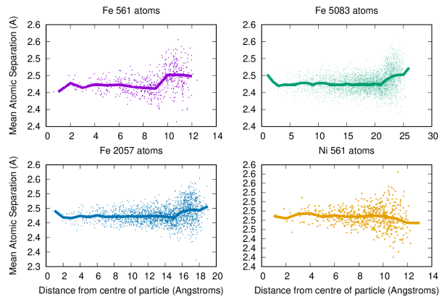
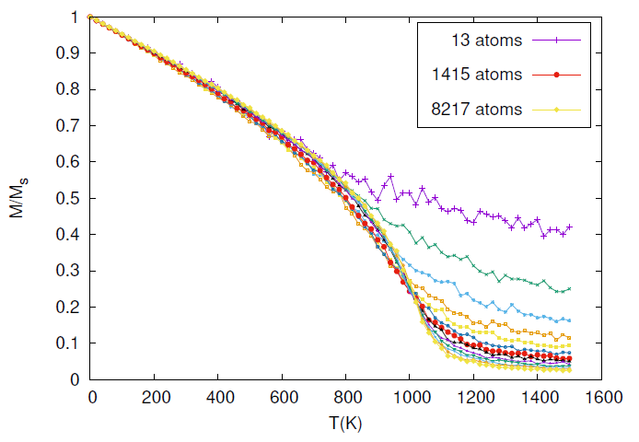
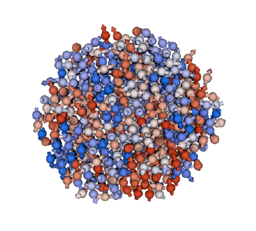
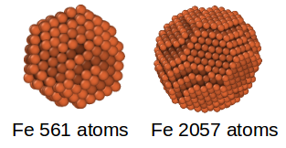
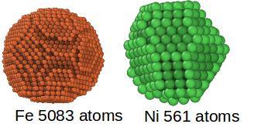
Structural Analysis
Results
Size dependence of the Curie temperature for nanoparticles de Fe
T=900K

Slide 4
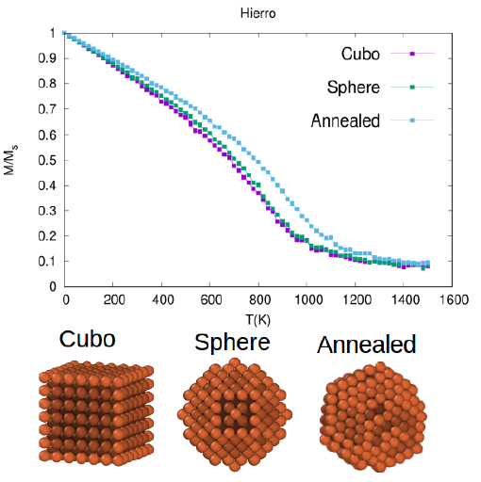
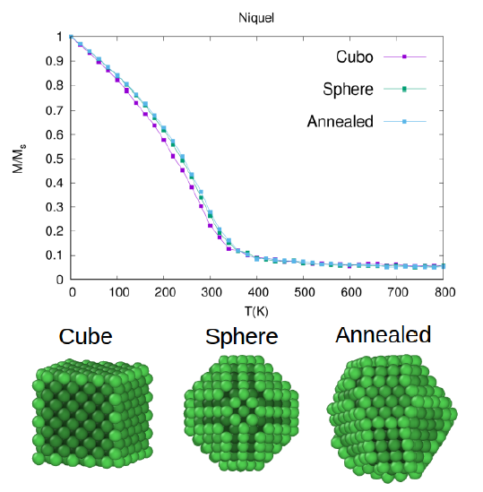
Results
Shape dependence of the Curie temperature for nanoparticles de Fe y Ni

