Slide 1
Synthesis of highly luminescent β-NaYF4: Ho/Yb@SiO2 nanoparticles
Wilfredo Rondan, Carmen Eyzaguirre

Slide 2
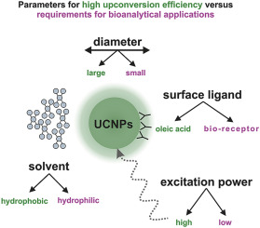
Introduction
The importance of Nanomaterials is in their size, located between the nanometric scale and the atomic scale, which gives rise to new properties or the improvement of existing ones.

Slide 3
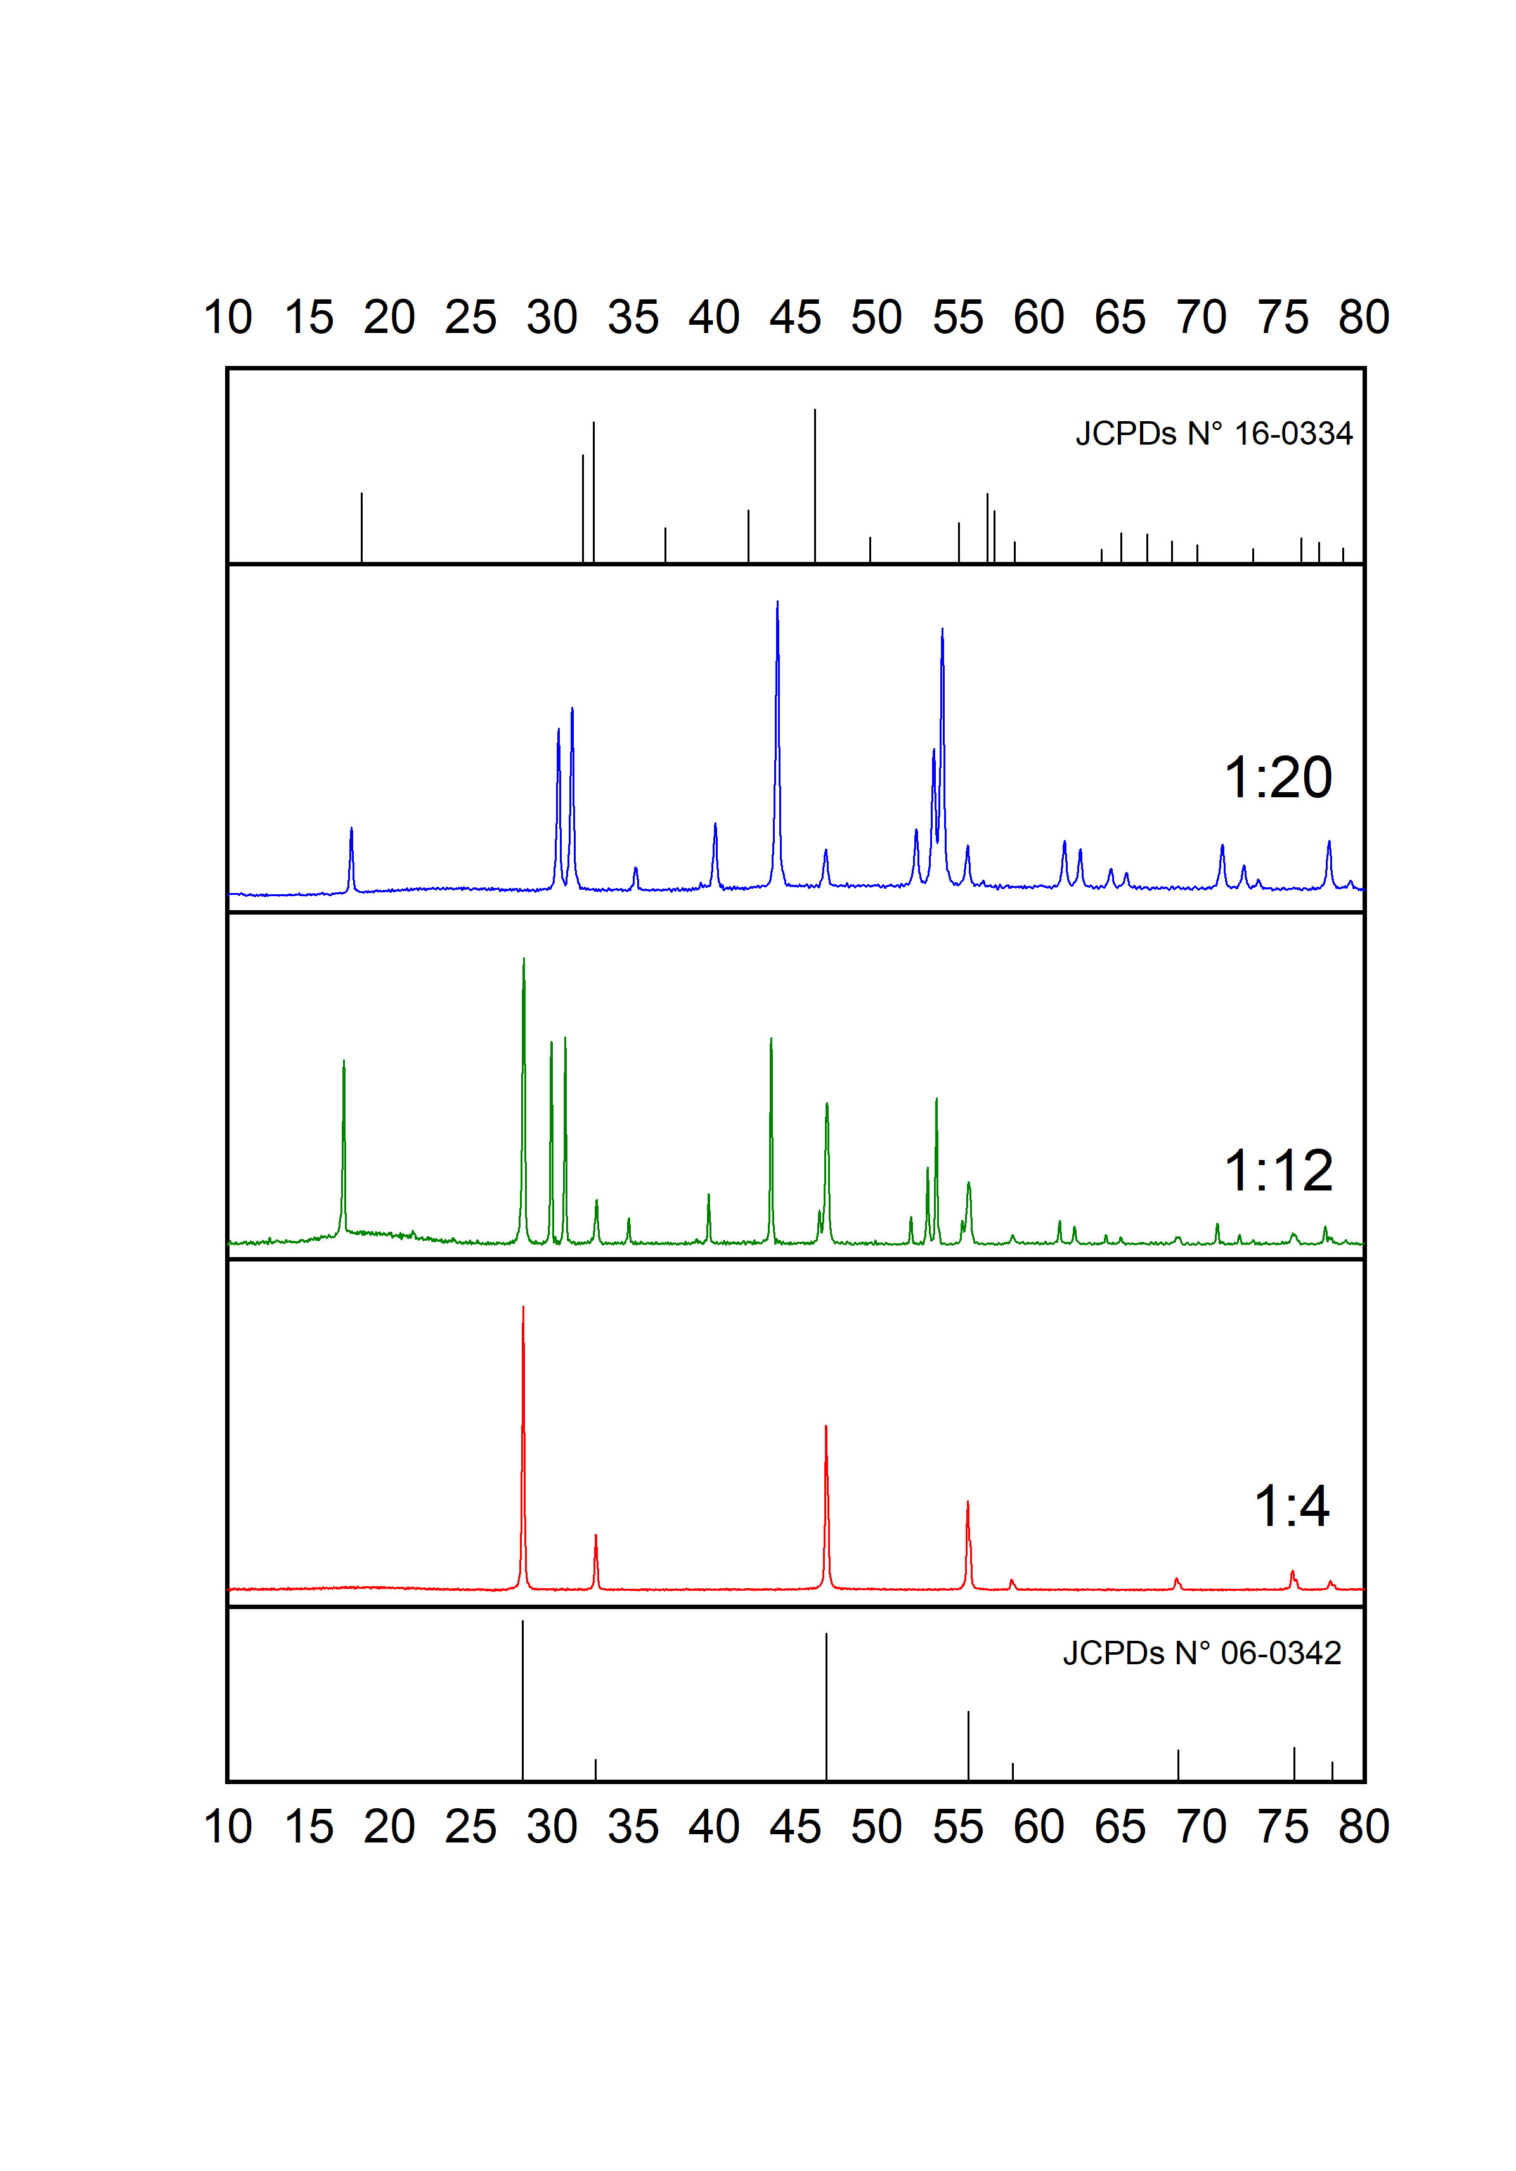
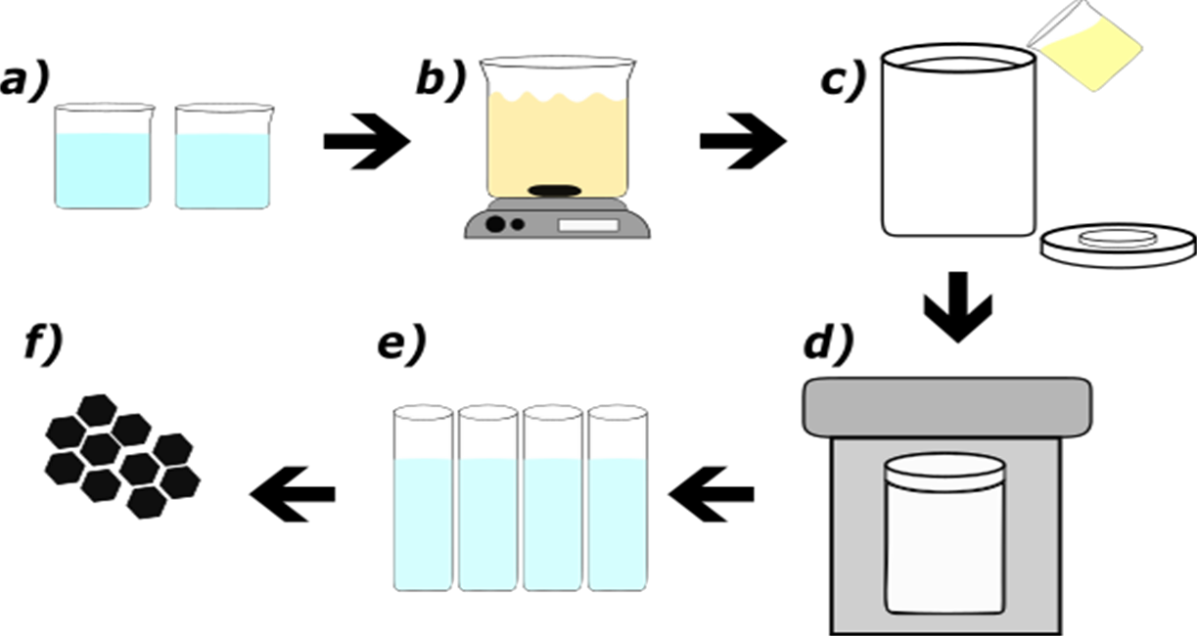
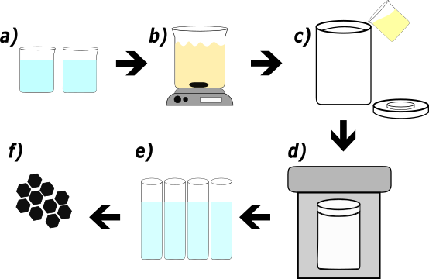
X-ray Diffraction (XRD)
Synthesis and Coating
a)
Diffractograms with variation of yttrium and fluoride ratios with Si02.

Slide 4
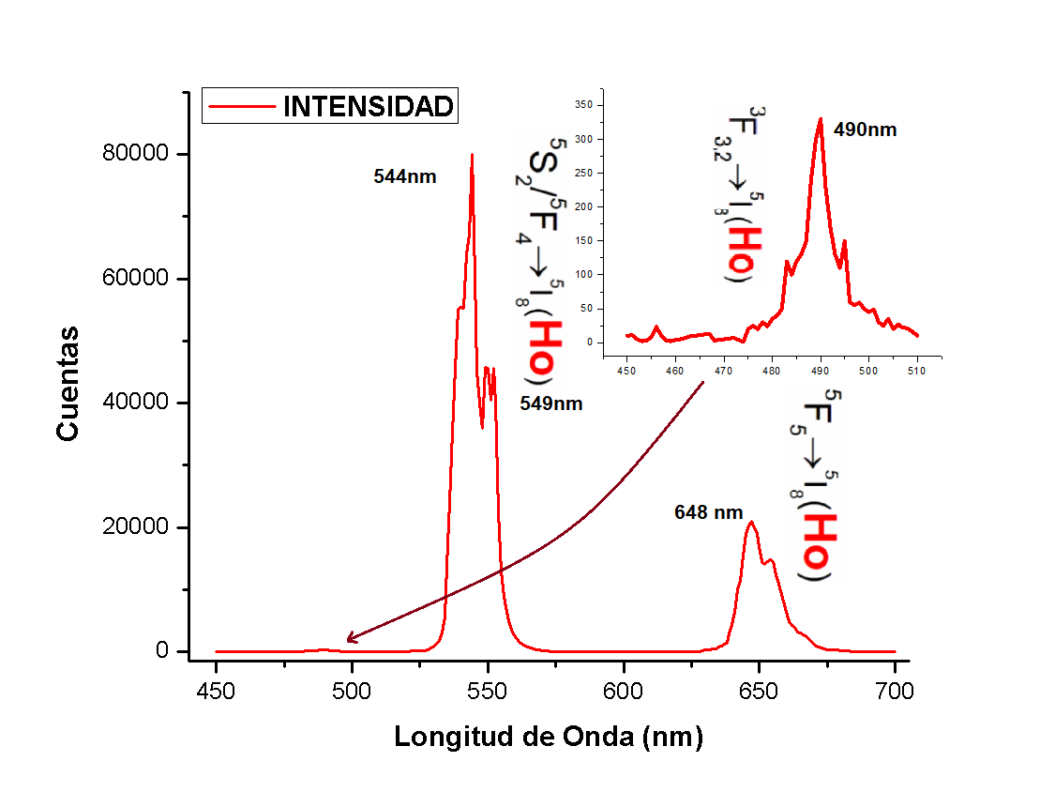
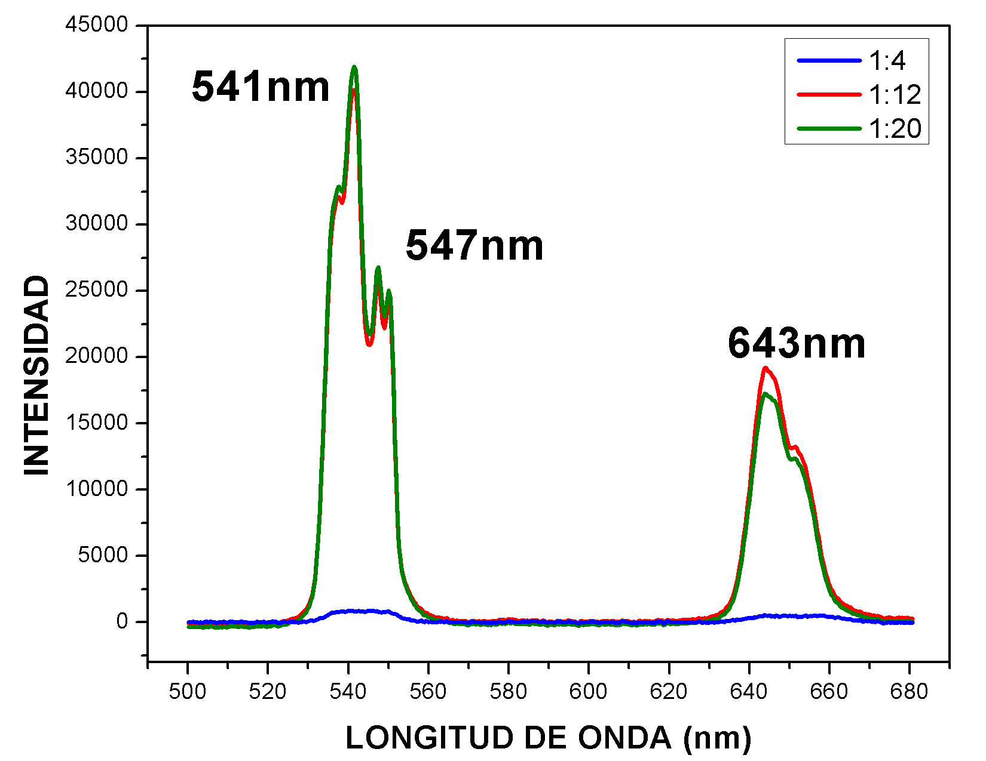
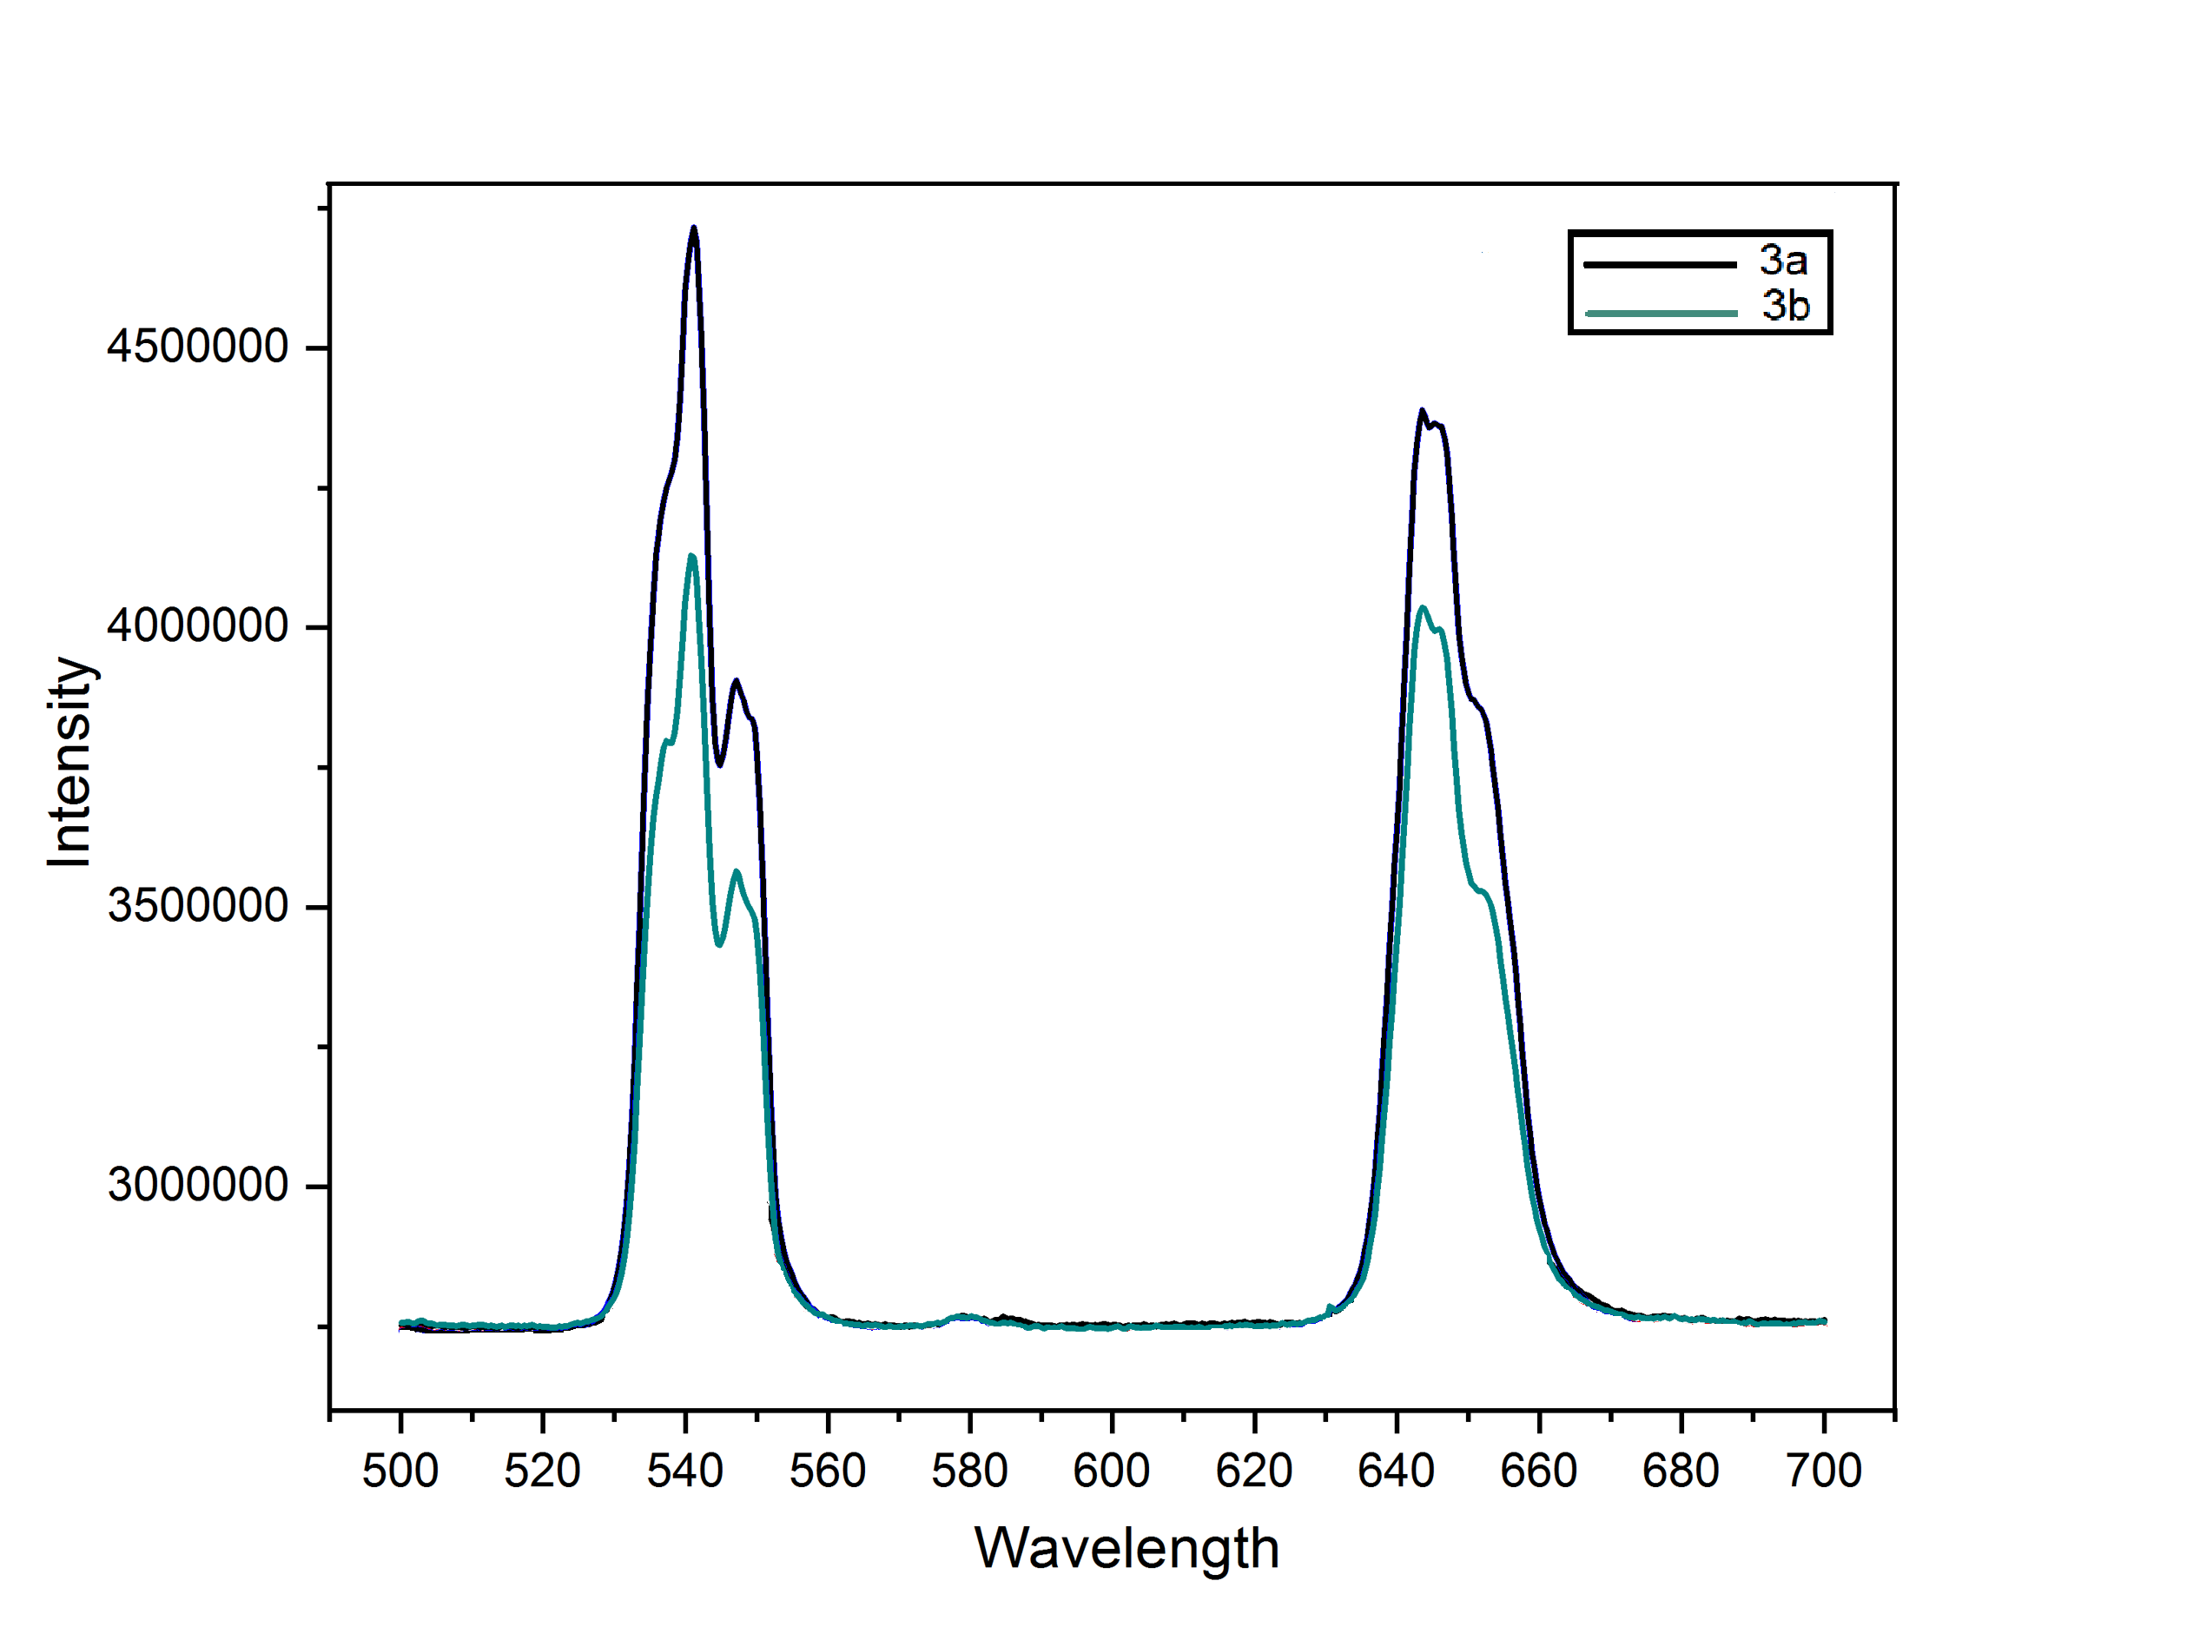
Emission spectra
a)
b)
c)
Emission spectra with variation of yttrium and fluoride ratios with SiO2.

Slide 5
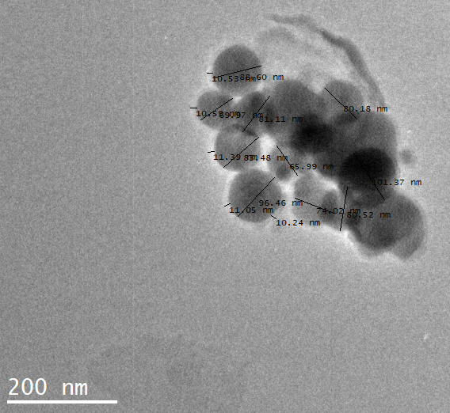
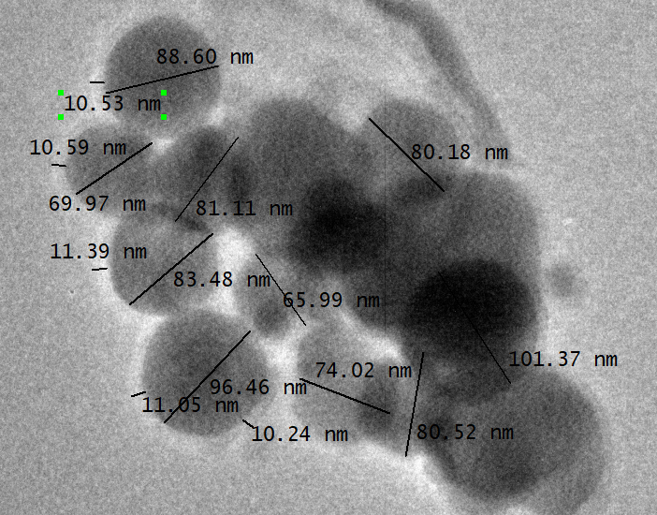
Transmission Electron Microscopy
a)
b)
TEM of samples coated with SiO2.

